Slide 1
EHCP Annual Reviews EY SENCO Network
Vicky Bruce
SENDACT Manager
Notes:
Developed by PCA Champions Group – schools, settings, agencies.

Slide 2
What is an Annual Review?
EHC Plans must be reviewed at least once a year to ensure the plan is
up to date
continues to provide the right support
Annual review preparation and meeting is undertaken within the setting
The 12 month annual review process is complete when the LA makes one of three decisions:
To maintain the EHC plan in its current form
To amend the EHC plan
To cease the EHC plan
Notes:
The annual review is not the 12 month marker – timeline later in the presentation

Slide 3
Legislation and Local Guidance
All those involved in the annual review process must be familiar with the
following national legislation and guidance.
Children and Families Act (2014)
SEND Regulations 2014
Special educational needs and disability Code of Practice: 0 - 25 years (January 2015)

Slide 4
Participation and Person Centred Approaches (PCA) Principles
Child, young person and family at the centre of the EHC assessment and review process.
Choice and control over their lives and support.
Includes what the child is able to do, what is important to them (now and in the future) and thinks about what support they might need in order to reach their potential.
Notes:
EY do this well. Strength within the sector

Slide 5
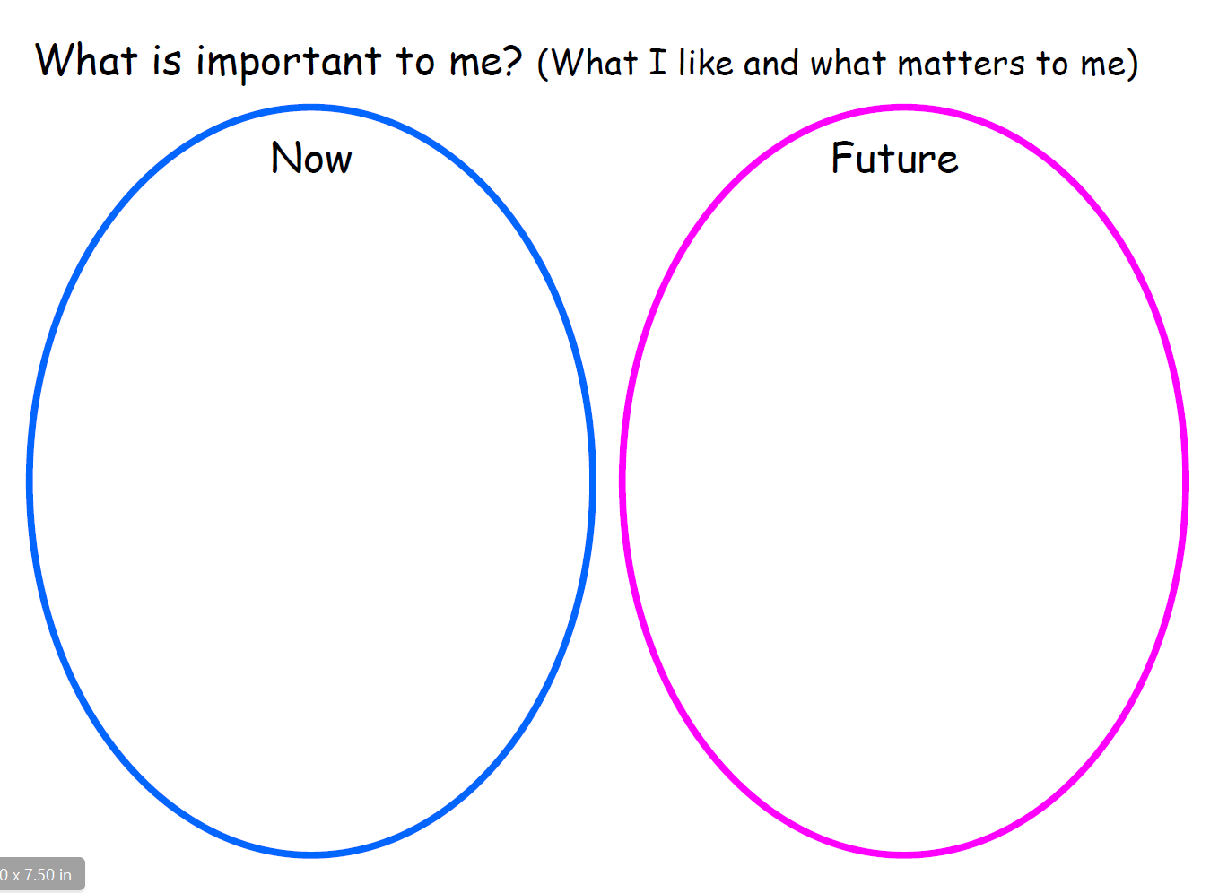
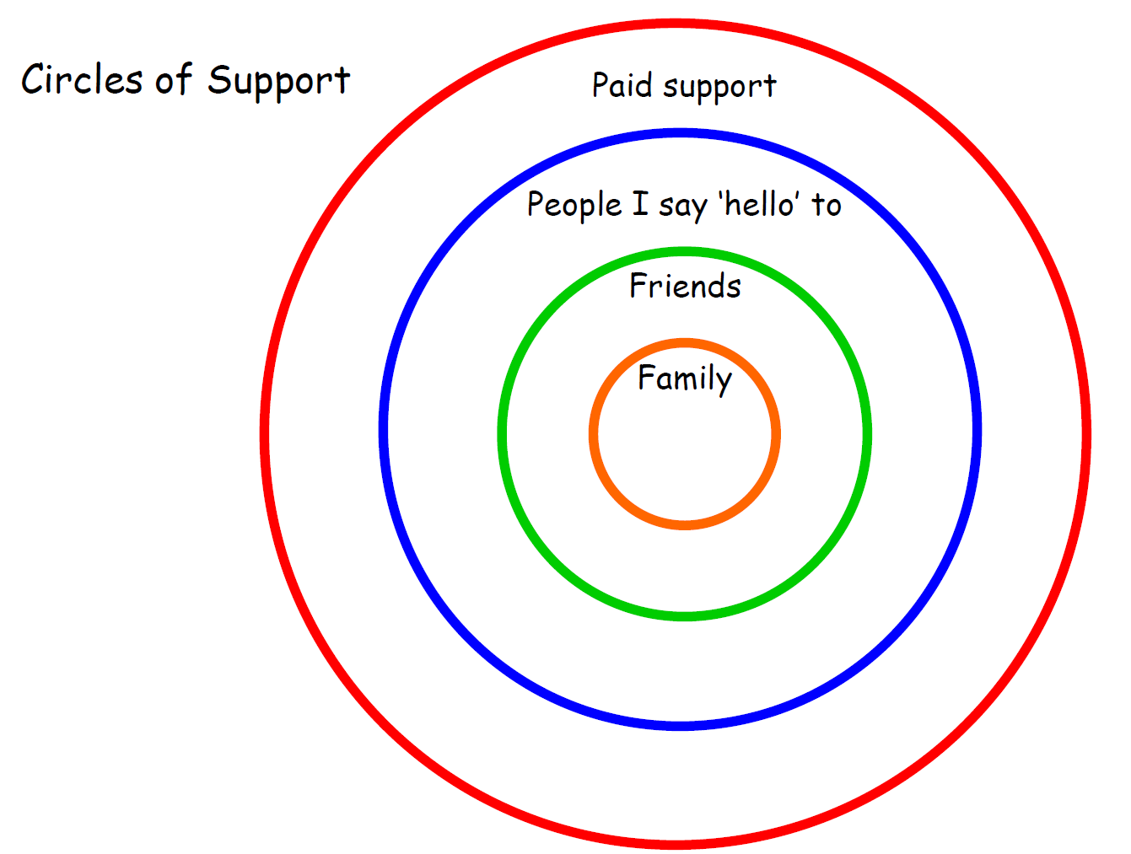
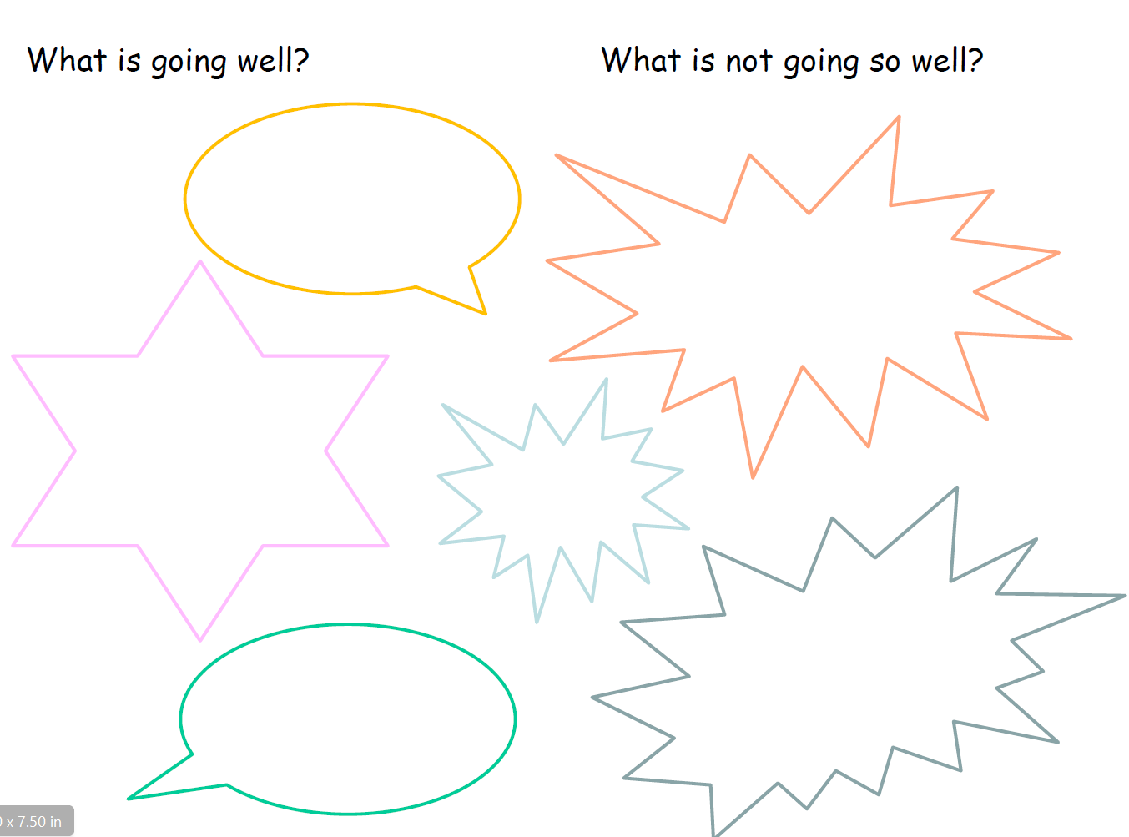
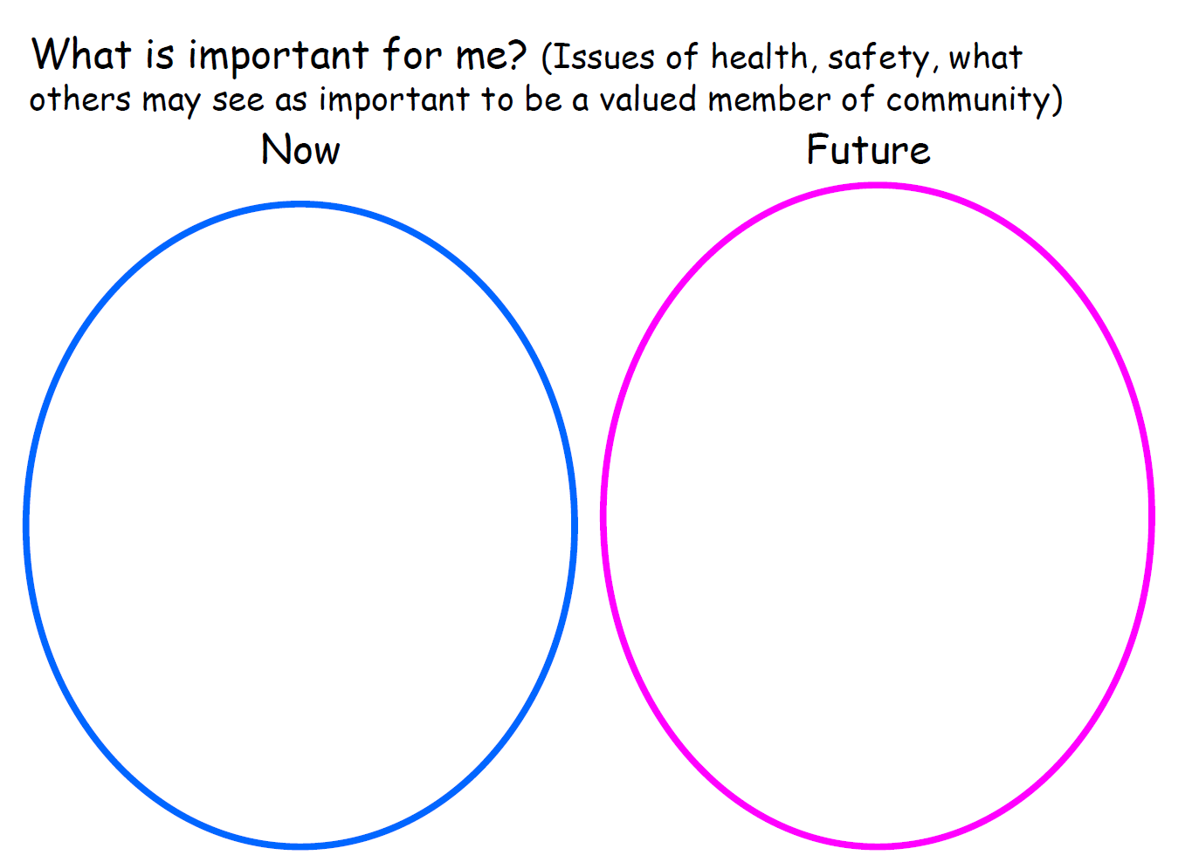
Participation and Person Centred Approaches (PCA)- Annual Review Toolkit
Notes:
Range of tools and templates – Ideas, flexible, neither prescriptive nor exhaustive.

Slide 6
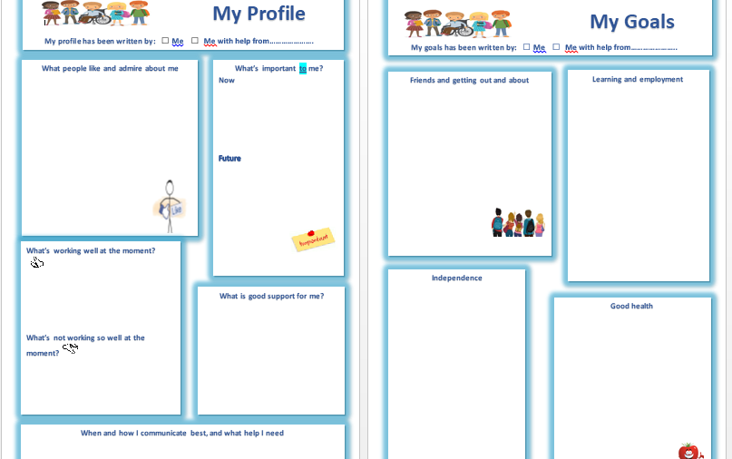
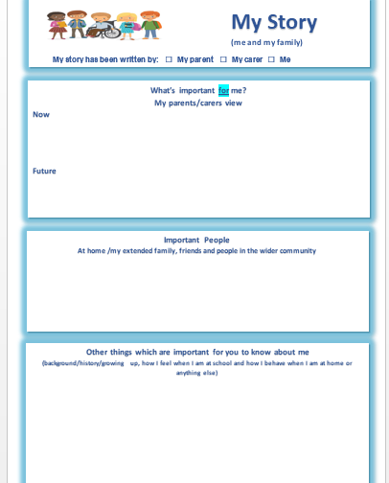
Notes:
Tool to capture the aspirations, wishes, thoughts and feelings of the child or young person at the centre of the process.
• It includes things like; What's important to me now and in the future, Whats working well and not working well, how I communicate best, what is good support for me.
Template but flexible and personalise to what works
Forms pre meeting report
Observations, advocate be specific (like fun but what is fun)
Not a one off

Slide 7
Participation and Person Centred Approaches (PCA): Contribution and Participation of Parents and Carers
Individual to each family
Typically this would include:
whats going well & not so well
what could make things better
any changes in their goals and aspirations for their child
Parents and Carers should always be invited, encouraged and supported to
attend, contribute and participate at the annual review meeting.
Notes:
Should participate as fully as possible in discussions and decisions as part of the annual review process.
Part of pre meeting report

Slide 8
Annual Review Preparation: Planning the Meeting
Meeting scheduled so that it is held and the paperwork submitted to the LA by the 11 month point.
Include the child and families when deciding who to invite to the meeting.
Invites must be sent at least two weeks before the meeting and must include the child, parents or carers, the local authority (SENDACT), any involved education, health and social care professionals
Consider combining with other meetings eg Child in Need, TAF review.
Advice (reports) and information about the child or young person in advance of the meeting from all parties.
LA invite is a statutory requirement although attendance by the LA is not required. SENDACT will attend only priority reviews.
SENDACT can provide support and advice in advance or following the meeting.
Notes:
is not it is not always necessary, appropriate or a good use of time for

Slide 9
The Annual Review Report Part 1 and Part 2
No longer two separate reports
Merged into one document
Part 1 (red sections) – pre meeting report
Part 2 (blue sections) – post meeting report
Part 1
Section 1 – General Information
Section 2 - Child & Young Person and Parents contribution
Section 3 – Development & Progress
Section 4 - Reviewing Outcomes
Section 5 - Special Educational Needs
Sections 6-9 – Not required for Part 1 report
Copies must be sent to the parents and all who are invited to attend the review meeting.
Notes:
Section 1 – All information accurate and up to date, includes all involved professionals
Section 2 – Child, YP and Parents contribution (covered)
Section 3 – Stength within EY - Current and previous (key insight for LA to where child is at)
Section 4 – Detail of progress towards outcomes, recommendation to keep outcomes or changes for discussion.
Target setting sheet and PATH (PCA tool) can be useful tools
Section 5 –Needs changes strengths nad needs to discuss and build upon in the review meeting

Slide 10
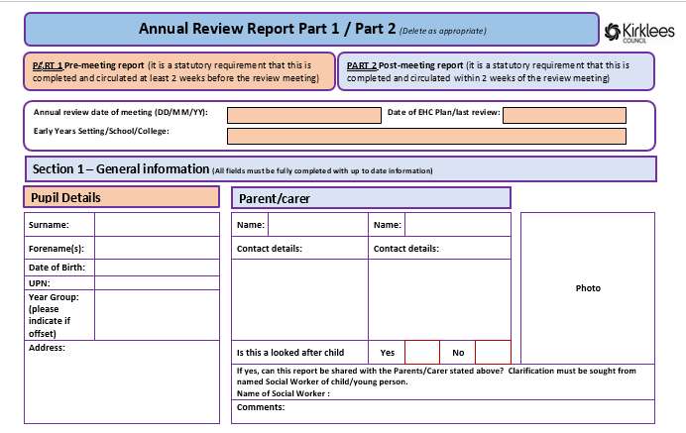

Slide 11
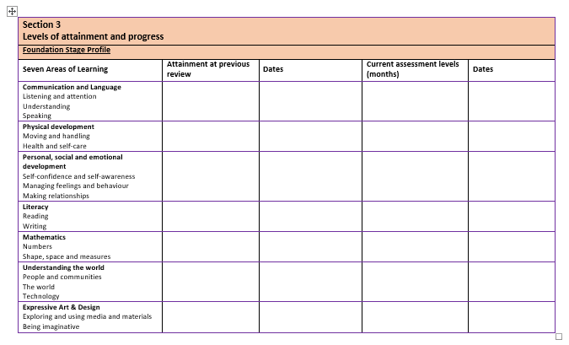

Slide 12
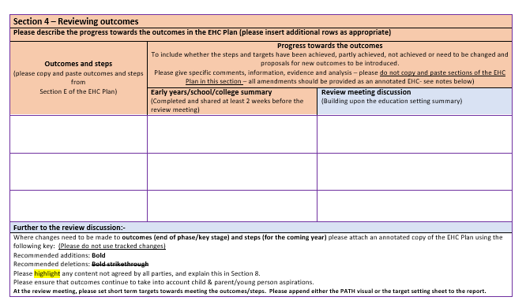

Slide 13
The Annual Review Meeting Structure
Chaired by the setting and held in a Person centred manner
Contributions of the child, young person and parents should be central to all discussions
Focus on progress towards the outcomes in the EHCP, and any changes needed to the outcomes or to the support in place to achieve these outcomes
Notes:
Anyone can chair or facilitate the annual review however
this is usually undertaken by the SENCO. Reviews are generally most
effective when led by the education setting as you know the child well,
have the closest contact with them and their family and will have the
clearest information about progress and next steps.

Slide 14
Part 2 and Annotated EHC (Post Meeting Report)
Blue Sections - Builds upon the information already collated in the Part 1 report.
Section 1 - General Information
Section 2 - Child & Young Person and Parents contribution14
Section 3 - Levels of attainment and progress
Section 4 - Reviewing the Outcomes
Section 5 - Special Educational Needs
Section 6 - Reviewing provision and support
Section 7 - Change of Phase Review
Section 8 - Additional Information
Section 9 – Recommendations - to maintain, amend or cease the EHCP
Finalise and Submit – Sign and Date
Copies must be sent to the parents and to all who were invited/ attended the meeting and submitted to the LA 2 weeks of the review meeting.
Notes:
How this information is recorded within the meeting has no set format and
may depend on the structure and content of the meeting. Some of the PCA
templates in the Annual Review Resource Toolkit which is available on the
intranet, may be useful to consider.
Section 2 – Ensure accurate and understood by all – held central to the further discussions in the meeting. Any changes to Section A should be made on an annotated version of the EHC.
Section 3 – Again accurate and understood by all
Section 4 and 5 –Using red section as the basis, plus report and further discussion – summary + annotated EHC for changes to outcomes
Section 6 - informed by the views, progress, outcomes and needs already discussed and provide a summary and
analysis of if any / what changes in provision are required and why. – summary + annotated EHC for changes to provision – specified and quantified.
Section 7 – those going into primary phase – Inclusion as the first point consideration. Parent views on future provision. Clear on what’s needed – ‘shopping list’
Section 8 – Anything else- differences in views, gaps, funding (change in provision or funding need to follow from change in need / provision)
Section 9 – maintain, amend or cease the plan.

Slide 16
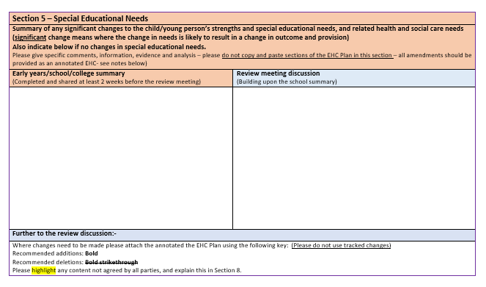

Slide 17
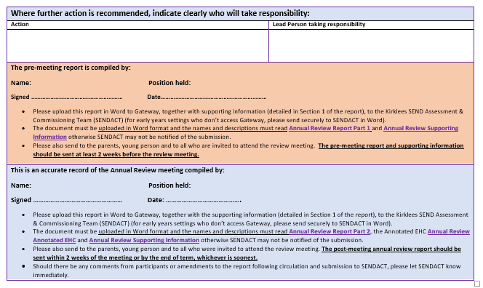

Slide 18
Completing the annual review: LA Actions
The 12 month cycle of the EHC is not fulfilled at the point of the meeting
being held, the annual review is complete when the LA make one of three
decisions:
To maintain the EHC plan in its current form – LA will send and Acknowledgement letter
To amend the EHC plan - SENDACT issue an Amendment Notice detailing the proposed changes to be made (Previously Proposed Amended EHC), followed by Final Amended EHC after consultation.
To cease the EHC plan – SENDACT issue a proposal to cease the EHCP.
The subsequent annual review cycle starts from the date of the acknowledgment letter or the amendment notice.

Slide 19
Paperwork, Guidance and Toolkit
Available on the Kirklees Intranet and Internet.
http://intranet.kirklees.gov.uk/Policies-and-procedures/Service/Schools/Special-educational-needs/Guidance-notes,-documents-and-forms.aspx
https://www.kirklees.gov.uk/beta/special-education/special-education-documents.aspx
Soon to be available via Business Solutions
SENDACT Contact Details
Victoria Bruce & Katie George – SENDACT Managers
Tracey McDermott & Alaina McGlade – SENDACT Deputy Mangers
SENACT@kirklees.gov.uk forename.surname@kirklees.gov.uk
01484 456888
Each setting is linked to an area team (Areas 1-5) this is determined based the admissions areas the setting is in (Currently being updated before distribution).

