Slide 1
Welcome to SENCoNet
Autumn 2022
8:30 – 9:00 networking and refreshments

Slide 3
Kirklees Specialist Outreach Services
Introductions and Updates

Slide 4
Service Overview
CCI
Cognition and Learning
Sensory/Physical
SEMH
Strand Lead plus Specialist Teachers and AETAs
Strand Lead plus Specialist Teachers and AETAs
Strand Lead plus Specialist Teacher
Strand Lead plus Specialist Teachers

Slide 5
Cognition and Learning
Mike Black
Strand Lead
Jamie Ecclestone – Specialist Teacher
Specialist Teacher
Marcus Farrington
Strand Lead
Kieran Blogg
Specialist Teacher
Stephanie Taylor
Specialist Teacher
Amy McGowan
Specialist Teacher
SEMH
Amanda McGarry
Specialist Teacher

Slide 6
Aims
The team works in partnership with mainstream schools to support staff in promoting the educational inclusion and achievement of pupils with SEMH and Cognition and Learning.
The key objective of the team is to enhance the capacity of mainstream schools to meet the needs of young people with complex SEND, providing high quality outreach services to support young people and schools across Kirklees.

Slide 7
Eligibility for Specialist Outreach support
Young people with C&L and/or SEMH in mainstream schools may benefit from accessing the specialist support available and will be considered for outreach if they meet the following criteria:
They attend a Kirklees mainstream school.
They have identified, assessed, or diagnosed C&L/SEMH needs. For many pupils, they may have some involvement from external mental health agencies like the Children and Adolescent Mental Health Services or the Children’s Emotional Wellbeing Services (CAMHS, ChEWS)
They are at SEND Support stage and have a My Support Plan (MSP) or an Education, Health and Care Plan (EHCP).
School have implemented interventions as part of the graduated approach and now require input from specialist provision staff.

Slide 8
Making requests for outreach support
The mainstream school completes a Kirklees Specialist Provision (KSP) referral form. Parental consent must be obtained prior to referral. ksp-referral-form-v8.docx (live.com)
We would like parent/carer and pupil views where possible.
Forms are submitted via secure email to Kirklees Specialist Provision specialist.provisions@kirklees.gov.uk
Panel meetings take place on a fortnightly basis during term time.
Referrals are looked at by a panel of professionals and careful consideration is given to the information provided by the school including the parent’s and young person’s views.
School will be notified of the outcome from panel by e mail.
If a case is allocated to a specialist provision team the Strand Lead is responsible for coordinating the support.
This support will begin with a Specialist Teacher contacting the school to arrange an initial consultation.

Slide 9
Core offer
An initial consultation will take place with school staff and parents. This will include:
Gaining the young person’s views
Gaining parent’s views
Discussion with the school SENDCo and other key staff involved with the young person such as the class teacher
Identifying a key member of staff in school that specialist provision can work with
Exploring any current or potential barriers to learning and development
Gathering information about progress towards current targets
Consideration of the level of expertise of staff and potential training and development needs
Obtaining an overview of the advice from other professionals involved
Supporting school staff to audit the environment using the Kirklees sensory toolkit to identify the possible impact of sensory sensitivities for the pupil and any resulting behaviours.
Supporting with requests for statutory assessment

Slide 10
Beyond the initial consultation, support may include:
Observations of the pupil in school and feedback to teachers and support staff
Working alongside school staff, modelling interventions and techniques around identified needs
Assisting teachers in the development of targets for the child
Providing specialist input into reviews and meetings
Linking with parents and carers
Liaison with other services
Training for school-based staff
Offering advice for transitions, this can include key transitions such as moving from primary school to secondary school, or change of placement

Slide 11
Northorpe Hall Child & Family Trust Helen Parker & Stacey Barton

Slide 12
Online Education Platform
New system for schools and colleges in Kirklees to improve access to information for children and young people who are known to Northorpe Hall Child and Family Trust and Thriving Kirklees. The information will be updated every day.
Have you managed to enrol?

Slide 13
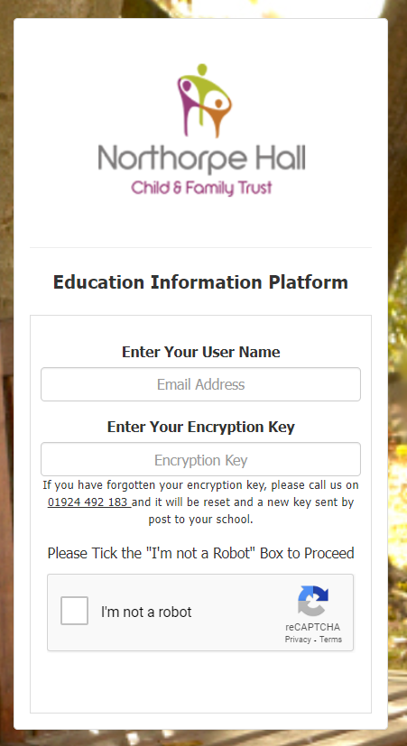
How to Log In
Install Authenticator app from app store
You have received a username in the post
You have received an encryption key via email.
Access the portal https://nhcft.uk/EducationInfo
You’ll see the screen shown to the right.
Enter your User Name and your Encryption Key and click the Google “I’m not a Robot” button.
A green “Sign In” button will appear. Click it.
The first time you log in you will be shown a QR code.

Slide 14
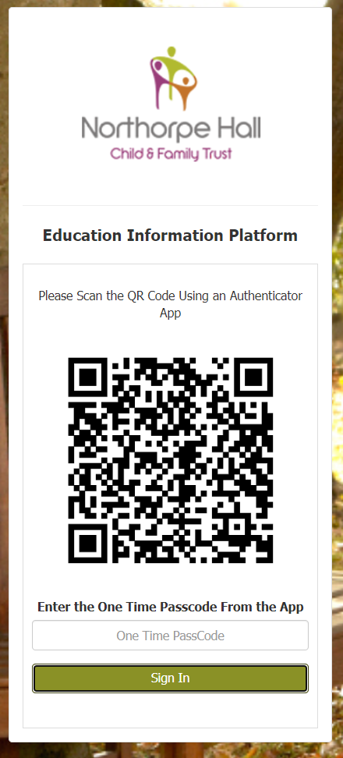
How to Log In
Open the authenticator app on your phone, add a new account/token and opt to scan the QR code. This should generate a six digit code.
When the code has been successfully scanned a new account will have been added to your authenticator app called Northorpe Hall (username).
The account should have a six digit number under it. Enter this into the One Time Passcode (OTP) box on the platform.
The one time passcodes expire in 30 seconds. If it does expire, the app will give you a new code to use.

Slide 15
Neurodevelopment Pathway Update
CAMHS are piloting a new referral pathway.
Parents and GPs cannot make a request for assessment.
Requests for assessment must be made by the SENCO, Educational Psychologist, a Speech and Language Therapist or a professional who knows the child well.

Slide 16
Neurodevelopment Pathway Update
Prior to making a request for assessment, the SENCO must create a picture of need from all staff who know the child and from parents.
The SENCO can book an appointment for a telephone consultation by phoning 01484 343184.
Referrer telephones the neurodevelopmental assessment service at the agreed time to discuss the referral. The appointment should take no longer than 30 minutes

Slide 17
Neurodevelopment Pathway Update
Referrals made before 19th July continue on the old pathway.
Referrals made after 22nd July need to follow the new system.
Telephone the Thriving Kirklees neurodevelopmental assessment service on 01484 343184.

Slide 18
CAHMS Crisis Team Offer
Link between CAMHs crisis and schools as lot of young people attending A&E and been referred to the service from schools.
Understand that its difficult for schools to manage pupils that are/may present with risky behaviours.
The offer is to assist schools in any way e.g. attending schools speaking to staff/parents, liaising with them via email with advice, supporting risk assessing and risk managing and discussing appropriate and inappropriate referrals to A&E/ Crisis.

Slide 19
CAHMS Crisis Team Offer
Jodie Flynn-Daly
Senior Mental Health Practitioner / Mental Health Nurse
Calderdale and Kirklees CAMHS Crisis and Home Based Treatment Team
Kirklees & Calderdale CAMHS
South West Yorkshire Partnership NHS Foundation Trust
jodie.flynndaly@swyt.nhs.uk
07826537323 Due to working shifts this number is not answered 24/7 and is not a crisis line.

Slide 20
Children and Young Peoples’ Domestic Abuse Support Service
Partnership service in Kirklees supporting children and young people who have previously experienced domestic abuse and are experiencing behavioural and/or emotional difficulties that may be attributed to their experience of this domestic abuse.
This service works directly with children and young people to understand how they feel about different areas of their life and what might be helpful for them moving forward.

Slide 21
Children and Young Peoples’ Domestic Abuse Support Service
This may include helping them to navigate a range of existing services, both statutory and voluntary.
It also offers access to therapeutic interventions appropriate to each child and young person to support them in their recovery from abuse.

Slide 22
Children and Young Peoples’ Domestic Abuse Support Service
Eligibility Criteria:
Child/young person has experienced domestic
abuse within their household
Are experiencing behavioural and/or emotional
difficulties that may be attributed to their experience of this domestic abuse
Are currently living in safe accommodation
Are aged between 3-21

Slide 23
Children and Young Peoples’ Domestic Abuse Support Service
How to make a referral:
All referrals are to be made through the Kirklees Early Support Partnership, further information about ESMAP (Early Support Multi Agency Panel) and the process can be found at –
https://www.kirkleessafeguardingchildren.co.uk/safeguarding-2/early-support/#
The referral form can be found at -
https://www.kirkleessafeguardingchildren.co.uk/wp-content/uploads/2021/03/Early-Support-Multi-Agency-Assessment-and-Referral-updated-120321-v6.docx

Slide 24
DfE Funded
Senior Mental Health Lead Training
3 years of funding £1200 per school/academy/college (not Independent schools)
Has to be used on DfE Quality Assured training- proof of booking required.
https://www.gov.uk/guidance/senior-mental-health-lead-training

Slide 25
Northorpe Hall SMHL Training

Slide 26
Support for Parents and Young People – www.northorpehall.co.uk
Notes:
Table 2: Look through the audit

Slide 27
Contact for any support….
Telephone: 01924 492183
Helen Parker
helen.parker@northorpehall.co.uk
Stacey Barton
Stacey.barton@northorpehall.co.uk
Keep up to date with us on social media:
Like our page on Facebook Follow us on Twitter Follow us on Instagram
https://www.northorpehall.co.uk

Slide 28
SEN Assessment & Commissioning Team (SENDACT)
SENDCO Network
12/10/2022
Notes:
Record session

Slide 29
Team Update School link officers New Assessments Annual Reviews Specialist placements

Slide 30
SENDACT Team structure
SENDACT Manager
Phase 1
Vicky Bruce
SENDACT Manager
Phase 2
Katie George
Phase: New Assessment
Deputy Manager (Phase Lead)
Tommy Marsden
Phase 1: EY, Primary & Kirklees Special Schools
Annual Reviews
Phase 2: Secondary & Post 16
Deputy Manager (Phase Lead)
Tracey McDermott
Various Service & Business Support

Slide 31
SENDACT Link Officers
Primary contact for technical queries related to EHC statutory processes
Individual case queries - unallocated cases.
Will not undertake all casework for named schools – we will be consistent, where we can.
Will not attend all annual reviews – not statutory or good use of SENDACT time – Advice pre and post meeting can be provided.
Education, Health and Care (EHC) Needs Assessments will be allocated within the New Assessment & Coproduction Phase – allocation will be informed on individual basis.
Please use Inclusion Support Offer (ISO) before your link officer
Information, advice and guidance related to:
SEND
SEND Support
General EHC matters
Notes:
Reference the graduated approach – Kate Browning and the inclusion model

Slide 32
EHC New Assessments
Increased demand and reduced capacity continues to impact allocation of EP advice and therefore assessment timescales.
Assessment prioritised in other streams of work eg CLA, Youth Justice, attendance, exclusions
All requests are progressing – settings and parents contacted upon allocation.
No additional updates can be provided by SENDACT whilst awaiting allocation.
In the meantime:
Do not delay in the implementation of provision or involvement of additional professionals.
Notify SENDACT of change of circumstance for the child or new professionals so we can add this to the assessment information / seek statutory advice.
Notify SENDACT of any intention to request special school or specialist placement (we would not typically expect immediate specialist school where EHCP is new)

Slide 33
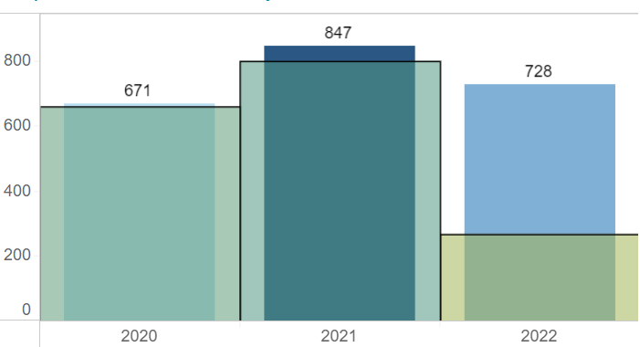
EHC New Assessments – Data
Requests for Assessment (not in Q4 2022)
Quarter 4 data
2020 - 197
2021 – 211
Estimated 2022 Total
Apx 928+ (10%+ ↑)
Decision to Assess Rate
71% Decision to Assess (Increase from 66-68%) 29% Decision Not to Assess

Slide 34
Annual Reviews – Early Years & Primary Data

Slide 35
Annual Reviews
SENDACT Attendance (Exception Only)
Amendments made in late 2021 & 2022 have updated plans onto the new EHC template format. This will continue for all plans requiring amendments.
Plan should not be expected to be updated on an annual basis. Plan will be amended:
Phase transfer
Significant amendments to outcomes and provision – impact on delivery.
Submit an annotated EHCP only where significant amendments are required – if no significant amendment, there is no need to submit an annotated plan.

Slide 36
Specialist Placement Requests
(Planned Sept 23 Start)
Increasing Requests :
20/21 – 228 requests - 47%↑ on 19/20
22/23 – 356 requests (to date) – 56%↑ on 20/21
Process:
Reviews held by end Sept 22
Paperwork to SENDACT by 7th October 22
Case preparation and consultations – Oct – Dec 22
Decision Making Group – Multi-agency decision making – w/c 9th Jan 23
Offer Day – Feb 23 (Date TBC)

Slide 37
Specialist Placement Requests
(Planned Sept 23 Start)
Placement decisions are only as good as the information made available through the annual review.
Good quality, robust decisions from good quality, clear accurate review information
Pressures - Sufficiency of special school placements (increasing capacity under SEND Transformation)
Opportunities – Inclusion
Additional Resourced Provision, Increased Specialist Teaching Range & Capacity, Special School @model.

Slide 38
Change of Phase and Specialist Placement Requests (Planned Sept 24 Start) – 22/23
Reviews will need to be held across the year for all pupils in the year before their final year in their current setting. (Y1 in infant only, Y5 in junior schools, Y10 in secondary or any other equivalent in nursery, first or middle school system)
Consider placement preference for the child to transition to.
Reviews held across the year
Where a specialist placement is likely to be requested, recommend holding in Spring 2 or Summer (up to date info for consults and decision making 2024 placements)

Slide 39
Thank you for your time
Any questions or feedback please email;
Victoria.bruce@kirklees.gov.uk (SENDACT Manager New Assessments, Early Years and Primary)
Katie.George@kirklees.gov.uk (SENDACT Manager Secondary & Post 16)

Slide 40
Early Years SEND Support : Update October 2022
Outreach expansion has continued and 4 Portex Teachers now supporting across Nursery and Reception in schools
Email was sent to schools September 28th outlining Portex Teacher support across the EYFS
Referrals for all areas of need in the Early Years are now coming to EYSEND except for children with specific HI , VI , PI needs ( Sensory and Physical will continue to respond to these referrals)
Portex Teacher Team : Sammy Burrow, Jill Taylor, Harriet Jones, Lizzie Wirth. ( some restructuring underway currently as Harriet on maternity leave from late November – you will be informed which teacher will be linking with you moving forwards)

Slide 41
EYSEND – Training updates
Early Years Autism Education Trust Training – we continue to deliver the AET Early Years training to both PVI and schools. This has been done through online and bespoke face tof ace offer
Making Sense of Autism ( Early Years) due to be delivered online: November 3rd and November 23rd bookings through Business Solutions
PVI SENCO Training – another cohort of 25 SENCO’s from PVI settings are now accessing LA led Level 3 SENCO training . Part of the continued work to support confidence and upskilling agenda across the EY sector
Portage Workshop Training for schools – Held summer term with excellent feedback. Another workshop will be offered Spring / Summer 23.
Dingley’s Promise Comic Relief Early Years Inclusion Project
Notes:
Expressions of interest – via email to myself or FAO me via Dewsbury psychology.

Slide 42
Our 5 year involvement in this national project continues.
Key aim being:
To increase the number of young children with SEND accessing early years and childcare places through:
üPartnership working with Local Authorities
üMeaningful Parental Engagement
üInvolvent with National Steering Group
üA Comprehensive and extensive free training offer
Notes:
Expressions of interest – via email to myself or FAO me via Dewsbury psychology.

Slide 43
Dingley’s Promise Project – Current Training offers:
Introduction To Early Years Inclusive Practice
Early Years SEND Transitions
Managing Behaviours that Challenge - NEW
Having Difficult Conversations with Families – NEW
Register interest for these online training packages via
https://dingley.org.uk/dingleys-promise-training/early-years-inclusion-programme/
Notes:
Expres

Slide 44
Possible Progress Monitoring Tools for children with SEND
Development Matters : 0-3 / 3-4 / Children in Yr R
– checkpoints ( 12, 15, 18 m, 2yrs , 3yrs, 4yrs)
Birth to Five Matters: Ranges 1-6
( 0-6 , 6-12, 12-18, 18-24, 24-36, 26-48, 48-60, 60-71)
Developmental Journal : Steps 1 – 14
Leeds SENIT Developmental Journal : Steps 1:14 and aligned to new EYFS
Derbyshire Celebratory Checkpoints : In line with new DM checkpoints
All available in the SENCO Professionals pages of the Local Offer

Slide 45
Early Years SEND Support ( EYSEND)
Educational Psychology & Early Years SEND Support
3rd Floor, Empire House
Old Wakefield Road
Dewsbury
WF12 8DJ
01924 483744
Dewsbury.psychology@Kirklees.gov.uk
Sharon.jagger@kirklees.gov.uk

Slide 46
KIAS (Kirklees) and SENDIAS (Calderdale)
Kias and Sendias provide legally based, impartial, confidential advice and support for parents of children and young people with Special Educational Needs or Disabilities, about education, health and social care. We also provide a service separately to children and young people should they request it.
What we provide
Advice on SEN support at school aged 0 - 25 years Support with mediation
Explain jargon and help with letter writing Help make sure you have your say
Explain the assessment process and your rights Go with you to reviews and meetings
Advice about Education Health and Care Plans Advice about exclusions
Tel: 0300 330 1504
www.kias.org.uk
www.calderdalesendiass.org.uk

Slide 47
The Government says that every Local Authority must provide an IASS – Information advice and support service We are jointly commissioned by Education, Health and Social care but are an arm’s length service which is independent from them

Slide 48
We provide legally based, impartial, confidential advice and support via - phone - email - face to face We can offer advice to schools/ parents & carers and also directly to young people themselves *We can only take referrals directly from parents themselves, but we can advise schools on general issues

Slide 49
We can help parents: - understand the support that a child or young person with SEND is entitled to - explain what SEN support in school may look like - help them raise their worries with school - help write letters and complete forms - help explain difficult language and jargon around SEND - attend meetings to review support

Slide 50
We also: -help parents to understand and advise them on the EHC needs assessment process - give advice about Education Health and Care plans - support them in annual reviews We also offer support to challenge decisions, including supporting in mediation and preparing appeals to SEND tribunal and supporting parents through the process

Slide 51
We can also give advice and support about exclusions in relation to a child with SEND by: - offering support to parents & carers in Governor Discipline Committee meetings - offering a free training session to Governors in relation to their duties to SEND and exclusions

Slide 52
Website: www.kias.org.uk
Telephone: 0300 330 1504
Joanne.grenfell@kias.org.uk
Samantha.booth@kias.org.uk
Sarah.knada@kias.org.uk
Ashleigh.williams@kias.org.uk
Danielle.hartley@kias.org.uk

Slide 53
Additional Needs Partnerships
Kirklees Educational Psychology Service

Slide 54
Why SENCO group consultations?
To acknowledge and utilise the wealth of expertise across the partnership beyond the EP time to support developments within and across schools
Shift from individual assessment and ‘diagnosis’ to collaborative and preventative work
EPs working with key adults to develop solutions together
Indirect model of EP service delivery, more effective use of time
Moderates/prioritises where available EP time is best spent
Consultations can be around individual/group/class issues so have a wider influence – using a solution oriented approach

Slide 55
Why solution oriented?
Lots of time spent working out what the problem is and what is causing it
Sometimes we get stuck in the problem or in following the same patterns of thinking and behaving - problems can’t always be ‘fixed’
S-O approach looks at ways of moving things forwards
S-O approach takes the view that you are the experts and the best solutions come from the group
In the meetings we discuss individual problems and key issues then turn our focus to areas that inform changes

Slide 56
Solution focussed discussion format………..

Slide 57
How does it work?
Half termly structured group consultation meetings, facilitated by EPs
SENDCO outlines current situation, what has been tried already, group listen and take notes as necessary
Group ask questions to clarify problem including affirmations what is going well
Group ask questions to clarify the desired situation, including contextual factors and interpersonal relationships
SENDCO and group invited to brainstorm strategies and resources
SENDCO feeds back what has been helpful
SENDCO prepares to write action plan
Move from clarifying the current situation to exploring the desired situation to finally considering strategies

Slide 58
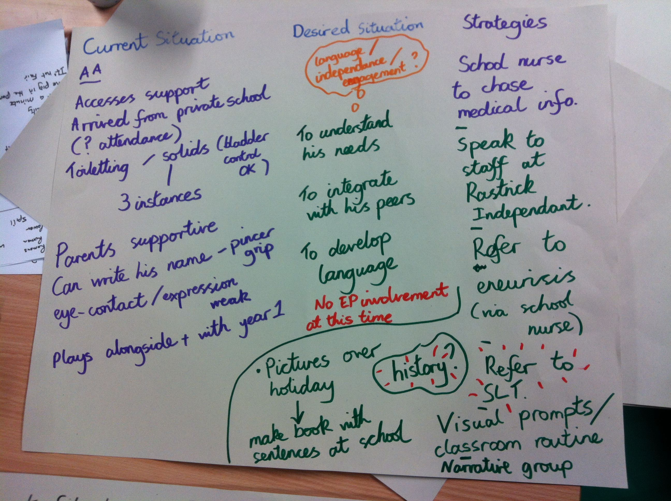

Slide 59
So, what about ....
Parents/carers?
Consent?
Paperwork?
Record keeping?
Code of Practice
Notes:
Things that crept in as we went along, the creative rush and excitement then the fundamentals……

Slide 60
Consultation Preparation and Action Plan
form

Slide 61
SEN Support
Notes:
SEN Support as ANP considered as external agency

Slide 62
Invaluable. This is an opportunity to discuss children on an anonymous basis and ask for help and advice, not only from the EP but from other colleagues in the LA; drawing on their knowledge and expertise to aid with meeting need and improving outcomes
An ANP meeting is a valuable joining of resources. When cases are presented we can all think of a child we have had in our own schools with similar difficulties. This means that we can share strategies but also we may have a child in our school who has similar challenges and taking note of the strategies given saves us from needing to bring that case to an ANP meeting
ANP meetings are so valuable for us as SENCOS to be able again have professional conversations, provide support and advice and be supported by others who understand this challenging role. The EP being part of this also provide amazing support

Slide 63
Invaluable. Sharing concerns, asking questions, sharing good practice and ideas is so important and can be done at these meetings. It is the only 'safe' space SENDCo's can get to together to share concerns and current issues and provision questions, the support of the EP helps to facilitate and develop this. Being a SENDCo can be very lonely and this time and group is of huge support
This is a really useful meeting and gives us a chance to work collaboratively, share ideas and look at cases with a 'fresh pair of eyes'.
As a relatively new SENCO, I have found the chance to work with more experienced colleagues and share my concerns about the children I work with hugely beneficial.

Slide 64
The perfect recipe …..
……….to avoid the perfect storm or drizzle:
Attendance: all SENDCOs and other school SLT, relevant EP/EPs
Discussion: process, time commitments, rights/ethics/confidentiality, HT support to SENDCOs, SENDCO responsibilities (to the group, parents and school staff), EP priority work (core vs traded)
Administration: ANP paperwork for all, email addresses shared, date set for first meeting
Any colleagues need information about their local ANP should contact Jayne Whitton:
jayne.whitton@kirklees.gov.uk
Notes:
Done it enough times to know what’s needed to make it work - Jemila

Slide 65
Home :: West Yorkshire Healthier Together (wyhealthiertogether.nhs.uk)

Slide 66
You may be aware that there are new updates to the JCQ exam access arrangements process for Form 8s. I have found a good (and free!) online course on the updates with Nick Lait, provided by Real Group training. It also has 3 SASC level accredited CPD hours when you complete the activities. I thought it may be useful for your secondary and FE SENDCos and exams officers. Here is the link:
https://realtraining.co.uk/free-access-arrangements-update-course

Slide 67
One important point to note is that the deadline for online applications has moved forwards from 31st to 21st March 2023.
If any schools do not have an in-house assessor with L7 and APC then I’d happy to talk to them if they want to discuss external assessor arrangements via helen@dyslexiaresults.com.

Slide 68
Free events and webinars Therapeutic approaches to support in the classroom
webinars@witherslackgroup.co.uk.

Slide 69
Kirklees Virtual School

Slide 70
Kirklees Virtual School - CLA with SEND
New SEND Lead working across all age ranges with EHC and SEN Support
Main Priorities :
Reducing drift and delay,
Ensuring appropriate provision that can meet need
Ensuring needs are identified and supported
Contact : Zara Costello on Zarad.costello@kirklees.gov.uk
Education Psychology planning meetings : Please could you ensure, if needed, you are raising with the EP team for any CLA who would benefit from input. Virtual school are also having planning meetings and will raise based on PEP meetings.

Slide 71
Changes to our systems and processes
EHCP’s for CLA
We are requesting copies of EHC review documents and final EHC to be uploaded please for consistency of approaches
Where possible we would like to have a joint PEP and EHCP review – PEP’s run once per term minimum. Virtual school staff to be invited to EHC review if not please.
EHCP reviews – some schools are holding these without Social worker present. If on ICO/FCO or S20, Kirklees LA have responsibility and so should be present.
PP+ funding requests moving forwards may not be approved for interventions that are part of EHCP and therefore core provision. We will consider these on an individual basis. Please ensure the school DT identifies if the target is over and above the EHCP offer to promote accelerated progress.

Slide 72
If you were previously involved in the discussions about the My Support Plan format and Provision Mapping, please could you indicate this on your feedback form
My Colleague, Anna Robinson, is currently looking at the MSP and would like to make contact

Slide 73
any colleagues wishing to contact the Locala OT team should contact Jessica Harrison:
Jessica.Harrison@locala.org.uk

Slide 74
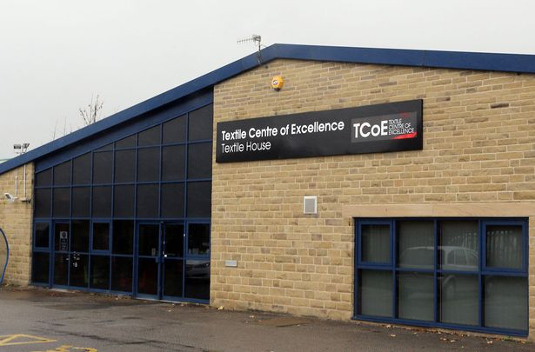
Next SENCoNet Thursday March 2nd 2023
Textile Centre
9:00 – 11:30

