Slide 2
Task groups
Task Group 1
Development of the inclusion pages on the local offer
Ali O'Neill and Richard Dresser -
Local Offer and Development Lead
Task Group 2
Graduated Approach and developing ordinarily available provision
Kate Browning - National Leader of SEND and external consultant
Task Group 3
Annual Review Paperwork and systems
Simon Ramsden
SEND Strategic Lead
Judith Nash -
SEND and Inclusion Improvement Partner
Kelsey Clark Davies / Judith Nash -
Head of Service Inclusion and Educational
Safeguarding
Task Group 4
EHC Application and systems
Decision Making Groups
Decision to Assess (Panel)
Task group 5 Provision Mapping
Judith Nash / Kate Browning -
National Lead for SEND

Slide 3
High needs review and workstreams
Summary
We are currently working on two change opportunities to improve outcomes for children and young people with SEND.
You might have heard about these already.
Valuing SEND
Inclusion Advice &
Support (IA&S)
Increased understanding of the range of needs, settings readiness and home confidence to meet them across Kirklees through use of the Valuing SEND approach and tool
Supporting settings to assess and meet the needs of children and young people by providing information, advice and guidance and co- ordinating access to multi- agency services

Slide 4
Valuing SEND (VSEND)
Key messages
Why are we doing this?
We are introducing VSEND to support settings, professionals and families have a single, rounded picture of children and young people’s needs and the support they need to prosper and succeed within and beyond their education setting.
What is Valuing SEND?
Valuing SEND tool is a simple tool which helps professionals and families to reflect on the child’s
needs, and the ability to meet these within the school and home.
It provides a series of prompts and questions to understand CYPs needs across each of the five domains.
Once the tool is completed (it’s an Excel document), it provides a clear diagram to demonstrate
where needs are being met and where additional support could be provided.

Slide 5
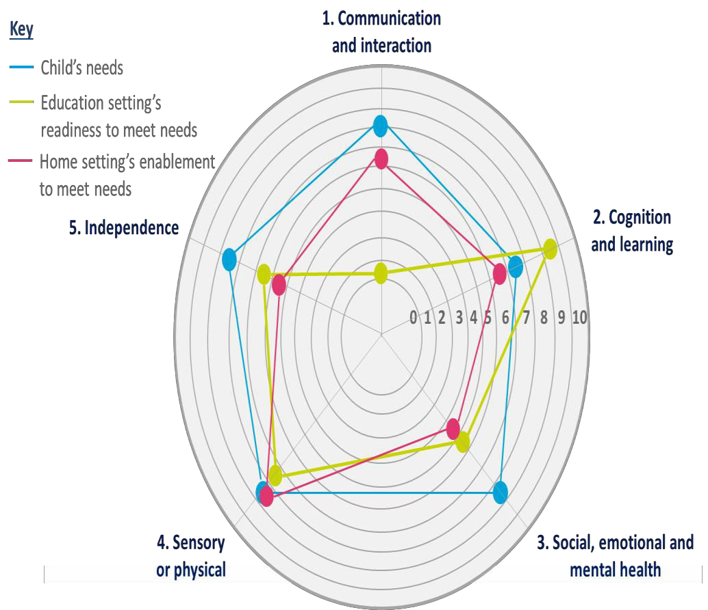
Valuing SEND (VSEND)
What does it look like?
VSEND is an excel tool
You answer a series of questions
across 5 domains
You apply an overall rating for the CYP
The tool automatically generates a radar diagram like this one
This identifies and highlights gaps
between:
  The needs of the CYP
  The setting readiness
  Home confidence
This supports provision planning
The tool can be used throughout
the CYPs educational journey

Slide 6
Valuing SEND (VSEND)
What’s happened so far?
The ambition is that eventually the tool will be used across all settings in Kirklees for consistency
This will take time though and the exact timeline is to be confirmed
Tools now being completed by the BBest hub
Weekly huddles for reflection, advice and guidance
Initial training with the majority of the BBest hub
Further roll out across Kirklees settings – exact timelines TBC
IA&S staff able to respond to queries
Training materials and Valuing SEND guidance available
On-going analysis of completed Valuing SEND tools

