Slide 1
The Role of the SENCo
THE CHILDREN & FAMILIES ACT 2014
Part 3: SEND
Session 3

Slide 2
This session we will be covering:
The Educational Psychology Service
Tracking progress and attainment
Preparing for Adulthood (PfA)
Health Support and Provision in Kirklees
Early Years Support/Transition to Adulthood
Transition between Schools and to new phases of education
Notes:
Sally

Slide 3
Discuss with colleagues on your tables:
How do you track progress for pupils with SEND?

Slide 4
How should I track progress?
Do it for all children on SEN Register
Assessment systems:
School: always ‘Below’or stuck at grade 1 or 2?
Age-related expectations for relevant year?
Standardised Tests
Doesn’t matter as long as can demonstrate tracking and therefore progress (or lack of it)
Termly
Notes:
Jayne

Slide 5
Pre-Key Stage Standards
These were introduced in September 2018 to replace P levels 5 – 8 and are used to report the end of Key Stage 1 or 2 statutory teacher assessment.
If you have students working at these standards, it is important to attend the moderation events to ensure that everyone is working to the same standard.
The next moderation event will be for English, at Castle Hill School at the end of February – it is for both mainstream and special school colleagues
Notes:
These standards could be used to track progress through Key Stages 1 and 2, but little work has been done on this

Slide 6
The ‘Aspects of Engagement’ will replace the summative assessment of P Levels 1 – 4 at the end of key Stages 1 and 2 for children who are not engaged in a subject specific curriculum
Likely to be introduced in 2021
P Levels 1 – 4 will be used until then
Free training available through Castle Hill School

Slide 7
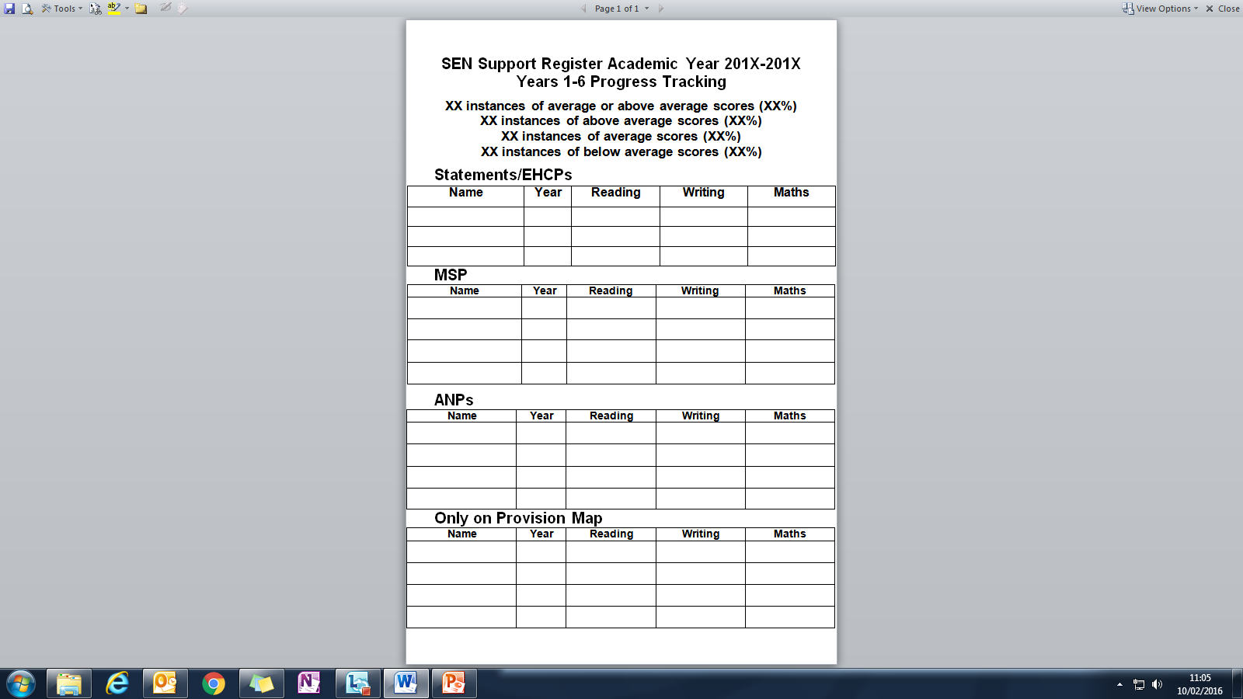
Example of SEN support Register
Notes:
May also need to consider WRM combined

Slide 8
Secondary schools will have also have a range of data available from different subject areas
If you can’t already do so, see if your IT support team can create a data set just for pupils in different year groups on your SEN Register: this will help you track progress and identify where support may be needed

Slide 9
Examples of standardised tests
Be clear about what information you want and when/how often you need it
TAs can carry out most of the tests with a little training/support

Slide 10
Reading and Spelling
Renfrew Word Finding Test/ Renfrew Action Picture Test
Marie Clay – Every Child a Reader
Hertfordshire Reading Test (comparative over time)
NEALES/NARA – Assessment of reading ability
YARC - York Assessment of Reading Comprehension (time consuming)
Vernon/British Spelling Test Series – for spelling
GL Assessment – group reading comprehension tests – NGRT
Gray Oral Reading Tests (GORTS) – Post 16
Wide Range Achievement Test (WRAT4)

Slide 11
Maths Basic Number Screening – ages 5-7 Basic Number Diagnostic – ages 7-11 Sandwell Early Numeracy Test
Communication ands Interaction
Communication Trust: progression tools
General Learning
British Picture Vocabulary Scale
Test of Memory and Learning (TOMAL2) – Post 16
Raven’s Progressive Matrices

Slide 12
SEMH
Boxall Profile
SNAP: Special Needs Assessment Profile
GL Assessment: Emotional Literacy - assessment tool
Thrive - good, but expensive, computer program
PASS (Pupil Attitudes to Self and School) - Not cheap, but all the work is done for you once data is inputted.
Notes:
Mention Emotional Well-being leads, Northorpe networks and newletters

Slide 13
Interventions
Test scores may indicate the need for an intervention, but interventions should not replace Quality First Teaching.
Try to ensure that links are made between what happens in intervention sessions and what happens in the classroom

Slide 14
Ensure that both staff and children understand why they are doing the intervention
Check progress regularly: if the intervention isn’t working try something else
Use evidence based interventions where possible
Make sure you have evidence of the impact of the intervention: this may need to be more than just standardised test scores – make it personal

Slide 15
On your tables compile a list of any interventions you use that are particularly effective for your pupils. We will compile a complete list from everyone and circulate it at our next meeting

Slide 16
Health Support for Schools
Tracy Biddle – Locala
Joanne Suggitt – Calderdale and Huddersfield NHS Foundation Trust

Slide 17
CHILDREN’S THERAPY SERVICES
Calderdale & Huddersfield NHS Foundation Trust
South Kirklees
Locala Community Partnership
North Kirklees
Speech and Language Therapy (SALT), Physiotherapy (PT) and Occupational Therapy (OT)

Slide 18
Therapists work with the child, parents and School to help reduce the impact of their difficulty on their physical, social, emotional and educational development.
We aim to enable the child to achieve their potential in communication, physical skills and independence.

Slide 19
How to refer
Open referral system (except OT in North – Consultant, GP or therapist only) – If parent self-refer, likely need to contact setting for more information.
Gain consent from parent
Complete referral form:
http:/www.cht.nhs.uk/childrens-therapy-services
www.locala.org.uk
Referral triaged by Therapist
Opt in process in some cases
Waiting list – waiting time
Assessment in clinic/setting (parent must be present)

Slide 20
CONSULTATIVE MODEL
MODERATE
• Ring fenced intervention
Assessment
SEVERLEY COMPLEX
• Contribute to MSP/EHCP
• Annual reviews
• Therapy programme
• Equipment
• Block of intervention
End episode of care
MILD
• Advice and discharge
• Onward referral/signpost

Slide 21
INCLUSION CRITERIA
Concerns regarding the development of speech or language or social communication skills, where the presentation does not follow the normal pattern of development or is significantly below that expected for age.
Child presents with a functional difficulty affecting motor skills, posture or self-help skills

Slide 22
EXCLUSION CRITERIA
Selective mutism when the speech and language skills are within normal range and the difficulty is primarily psychological.
Motor skills in line with overall developmental profile.
Sensory processing difficulties.
When child has been previously seen and has been discharged unless:
- There is an identified change/new problem
- There is an identified change to the environment and/or change in readiness for intervention.

Slide 23
Any questions
?

Slide 24
Educational Psychology Service offer
Applying psychology thoughtfully – Acting with integrity – Making a difference Placing children and families at the heart of what we do

Slide 25
Core offer for ALL schools:
Allocated school contact EP
Termly planning meetings where priority work is agreed and time for consultation around other children/young people where there is a high level of concern
Priorities:
Statutory assessment (EHC)
Statement reviews for CYP where a significant change in need/type of provision indicated
Looked after children
At risk of permanent exclusion (in partnership with PRS)
Critical incident support
Additional Needs Partnership meeting support and facilitation
SEN Support for maintained schools –consultation for complex cases
SEN Support for Academies - managed through a traded offer

Slide 26
SEN Support involvement:
Cases for EP involvement at SEN Support usually determined at the Termly Planning Meeting and the most complex agreed for EP consultation.
School complete EP consultation Request Form
and send into EPS
EP makes contact with school to arrange date for consultation with key adults in school and parents/carers
Strategies/advice given as an outcome of consultation
School determine how best to utilise advice
Any further support can involve EP (school’s choice) as part of traded offer

Slide 27
Additional Needs Partnerships:
Groups of SENCOs working together alongside EPs to share skills and expertise
Structured solution focussed meeting facilitated by EP designed to develop solutions for concerns around individual children, groups of children or whole class issues
Sharing of skills and expertise across the group
Sharing of resources and practice
Efficient and effective way of developing capacity to meet school based needs

Slide 28
Half termly meetings
Majority of issues/concerns are met through the group consultation
Where extremely complex, group determine individual EP consultation with school and parent

Slide 29
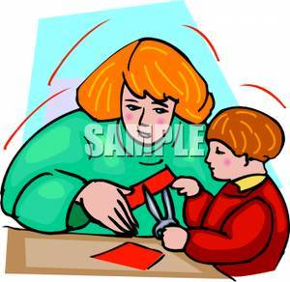
Educational Psychology : Why start with consultation?
Establishing trusting relationship
Combine expert knowledge
Tailoring assessment and intervention
Involving adults most important to the child
Moving to action – solution focused

Slide 30
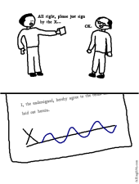
Traded offer
Available to all schools
Service Level Agreement (guaranteed to deliver)
PAYG (dependent upon capacity)
Any requests are discussed with school to determine
Purpose and type of support needed
(individual/group/systems/staff development)
Principle of being efficient and effective
All information on SLA OnLine

Slide 31
Educational Psychology
If you have any queries or would like to know more about what our service can do for your school, either through our core (LA funded) or traded (bought-in) offer, please do not hesitate to contact your allocated school EP or our senior management team as follows:
Jayne.whitton@kirklees.gov.uk (Principal Educational Psychologist)
Janet.wilkie@kirklees.gov.uk (Senior Educational Psychologist)
April.frearson@kirklees.gov.uk (Senior Educational Psychologist)
Samana.saxton@kirklees.gov.uk (Senior Educational Psychologist)
Contact address:
Educational Psychology & EYSEN Support Service
Empire House
Dewsbury
WF12 8DJ
Telephone: 01924 483744

Slide 32
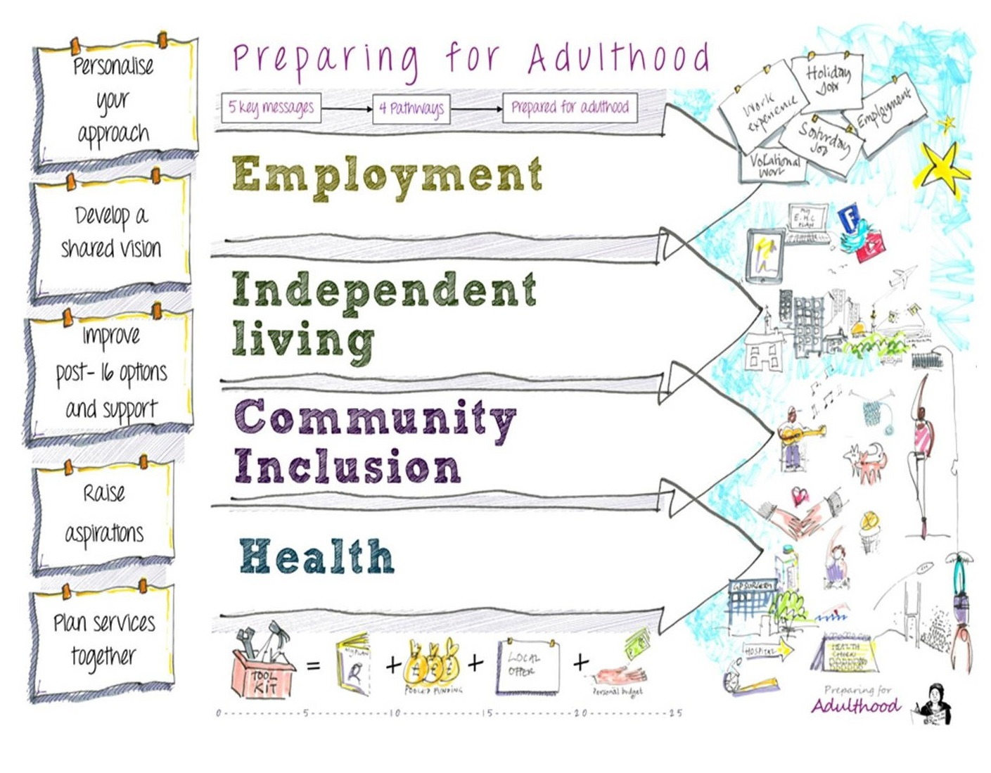
Preparing for Adulthood Outcomes Tool: from birth onwards
www.preparingforadulthood.org.uk

Slide 33
The Preparing for Adulthood themes will be included in the Annual Review paperwork in the future, for year 9 onwards.
However, the aspirations of children and young people link to these themes from a very early age and should be considered as early as possible

Slide 34
Have a break!

Slide 35
Kirklees Outreach Support and Specialist Provisions
Clare Burdett
Esther Marper

Slide 36
Specialist Provision Sensory, Physical Impairment and Complex Communication and Interaction
Wednesday 26th February
2020
Clare Burdett and Esther Marper – Strand Leads

Slide 37
Who are we?
Kirklees Sensory (Hearing and Visual Impairment), Physical Impairment and CCI Outreach Teams
The teams have specialist knowledge, understanding and wide ranging experience of working with children with sensory (HI and VI), physical needs (PI) and Complex Communication and Interaction (CCI).

Slide 38
Specialist Provisions - Outreach Roles
Staff you may meet:
Qualified Teachers
Specialist ETAs
Educational audiologists
Technicians
Habilitation Specialists
Family SEN Worker

Slide 39
What are our aims?
We aim to:
Enable school staff and families to identify, understand and confidently meet the needs of children with sensory, physical and/or CCI needs in Kirklees
Ensure that they are fully included in their mainstream schools
Help raise expectations and achievements of these children

Slide 40
As an outreach service we:
Consult with school staff, families and carers
Provide specialist advice and training
Work collaboratively with health and medical professionals
Signpost families and staff to other organisations and services

Slide 41
The outreach teams consist of staff with specialist knowledge and experience of:
Different types / levels of HI or VI impairment
A range of physical conditions
A wide range of communication and interaction difficulties including Autism
They are able to provide schools with an understanding of the conditions and their expected impact on learning.
Some children may have complex needs, requiring support from all 4 outreach teams.

Slide 42
How can you access our service?
HI and VI children are mainly referred by health professionals.
PI children and those with CCI are not currently referred by health professionals.
It is the responsibility of the educational setting to refer through an SPR (Single Point Referral V4) form.
Schools may refer and re-refer concerns about children with VI and HI through submission of an SPR form to Panel.
Contact Kelly Smith: kelly.smith@kirklees.gov.uk

Slide 43
Promoting Independent Mobility
Students with VI and PI should be encouraged to move around school as independently as possible from a young age.
They may use a variety of aids:
Canes
Wheelchairs
Crutches
Walking frames
Lifts

Slide 44
Promoting Inclusion
Children should not feel excluded because of their impairment or the equipment they may need.
The outreach teams are there to advise on:
Access to classrooms
Seating
Adapted equipment
Inclusive / adapted timetables - wherever possible

Slide 45
Impact on Teaching and Learning
Whatever a child’s impairment, they are at school to learn!

Slide 46
Removing Barriers to Learning
Typical barriers to learning:
Short or long term absence
Slower processing and response time
Fatigue
Slow pace, lack of stamina
Other medical conditions
Restricted access - restricted curriculum

Slide 47
Impact
Unfinished work
Lack of continuity
Attainment below potential
Missed social and extra curricular experiences
Lack of social skills
Difficulty building and maintaining friendships
Low self-esteem
The outreach teams can work with your children to help minimise the impact of their impairment on learning and social skills.

Slide 48
Home Life
Limited life experiences
Lack of social opportunities
Time spent on transport - leading to fatigue and lack of energy for homework
Parents unable to communicate with their hearing impaired child
Everything is harder; exercise programmes, postural equipment, multiple hospital appointments; disturbed nights
Often, simple outings must be planned in advance; no room for spontaneity.

Slide 49
Strategies
Working together, we can make learning more accessible by:
Setting achievable goals
Using appropriate level of language
Setting personalised language targets
Providing processing time
Presenting tasks in an accessible format
Giving clear and consistent expectations in terms of work and behaviour
Encouraging pride in all achievements, however small

Slide 50
Strategies
We can work with you to ensure your children have appropriate support:
Effective communication
Sensory, PI and CCI friendly classrooms
Promoting inclusion – encourage friendships
Promoting independence and development of life skills
Using adapted equipment
Advance preparation of resources, e.g. photocopying / enlarging, concrete objects / aids
Preparation for operations
Home visits / schooling following operations

Slide 51
Communication
Know your students’ abilities – don’t underestimate or overestimate! (We can help you to develop a better understanding of a child’s conditions/difficulties and their implications.)
Speak to your outreach staff about any concerns you may have regarding learning, communication, life and social skills

Slide 52
A happy child is a child who feels...
Safe
Comfortable
Valued as a person
Given the opportunity to achieve as much as possible
Treated the same as peers wherever possible

Slide 53
Sharon Jagger: Early Years SEN Support
Melanie Armitage: Community Enablement Team/My Life Team

Slide 54
Transition from school to school/college
SEN support should include planning and preparation for the transitions between phases of education and preparation for adult life …..To support transition, the school should share information with the school, college or other setting the child or young person is moving to. Schools should agree with parents and pupils the information to be shared as part of this planning process.
SEN CoP

Slide 55
The High Needs Review identified transition as a key point at which things start to go wrong for children and young people with SEND and this is being addressed through the High Needs Action Plan, with the aim of developing a transitions protocol that will be used across education
Notes:
Secondary colleagues may need to start to think a bit more about supporting young people’s transition to college or working with local college to do this

Slide 56
The Kirklees Transition Protocol sets out our expectations of how children, young people and their families will be supported through a range of transitions

Slide 57
On your tables…….
Have a brief read through the protocol and discuss anything in it which you would expect to do, or would find difficult to do?
Notes:
Feedback

Slide 58
Homework!
Have a look at an appropriate ICAN case study (primary/secondary)
Use the Graduated Approach document and the Communication and Interaction guidance to develop a plan for the child.
Consider how you would track progress.
OR
Bring your own case study to the next session. This will be about a child you think may need an ANP/IEP or MSP. Use the Graduated Approach Guidance to make your case
Notes:
To use if time permits

Slide 59
Any questions?

Slide 60
See you on March 3rd 2020 for our final session

