Slide 1

Welcome to SENCoNet
Spring 2022
9:00 – 11:30

Slide 2
This morning’s agenda
Time slot | Item | Delivery
9:00 | Welcome | Sarah Grant
9:10 | Tracking progress in the early years | Sharon Jagger
9:20 | LA Up-dates | Kelsey Clark-Davies
10:05 | Occupational therapy up-dates | Ann-Marie Dennis
10:20 | Comfort break
10:35 | Valuing SEND | Phil di Leo and Aadam Ahmed
11:15 | Multi-Systemic therapy | Collette Beatson and Donna Dyson

Slide 3

SENCo apprenticeship to be available soon
(September 2022 potentially)
Kirklees TA SEN apprenticeships still available

Slide 4

Part-time timetables for children with an EHCP
Education Safeguarding Resources | Kirklees Business Solutions
Reduced Timetable Guidance September 2021

Slide 5
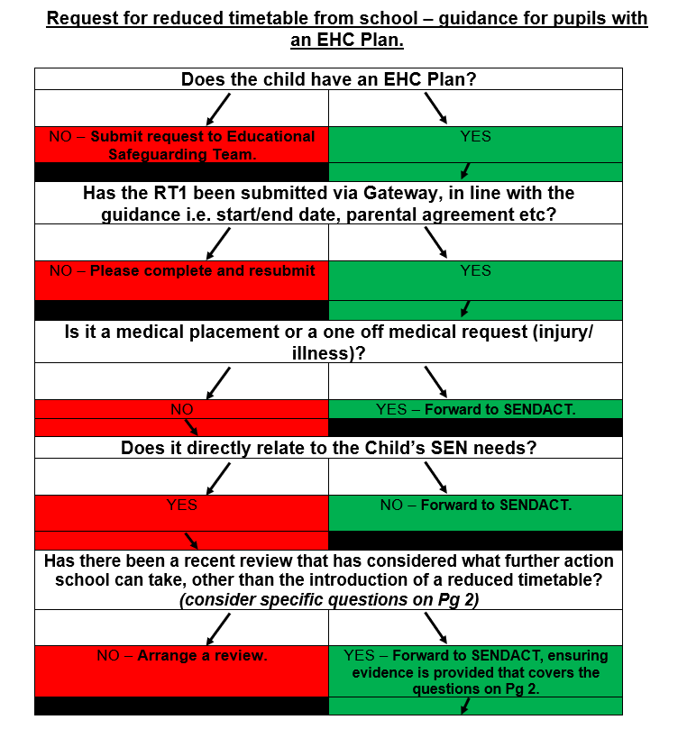

Slide 6
Evidence will be required to demonstrate that all of the below questions have been appropriately considered, when submitting a reduced timetable request for a child with an EHC Plan:
When was the last review held and did the review consider the issues relating to this request?
Are there any potential factors that have caused the change in the child’s behaviour that has initiated the request for a reduced timetable? E.g. issues in the child’s personal life, changes at school. Are these factors something that can be dealt with by school through means other than the introduction of a reduced timetable? E.g. differentiation of school routines, avoiding congested times etc.

Slide 7
Have any additional provisions been introduced recently and if so, what impact have these made? Are there any staff training issues that have been identified that would help meet the child’s needs?
Have external agencies or the PRU been providing support for this pupil?
How will the provision within the EHC Plan be implemented?
What will the plan be if the reduced timetable doesn’t have the desired result? Does a specialist placement request need to coincide with the reduced timetable?

Slide 8

Schools should be mindful when submitting requests for reduced timetables that a decision on the request could take up to three weeks to process. The guidance is clear that a reduced timetable must not be implemented without all of the relevant signatures being received so schools will need to factor in this processing time when completing their request.

Slide 9
Early Years SEND Support : Update February 2022 – Sharon Jagger
Team update – expansion and remit including Portex Teacher recruitment
Early Years EHC Requests
SENDIF Funding
Training information – Level 3 Early Years SENCO Award ; Portage Training ; AET Early Years Training ; Dingley’s Promise

Slide 10
Updates & a New Name!
EYSEN – now EYSEND - single letter shift but significant also
Referral form and linked materials in process of being changed
Latest referral form on local offer:
https://www.kirkleeslocaloffer.org.uk/senco-professional-information-and-resources-page/referral-forms/senco-referral-forms/
Referral surge evident - 212 referrals Autumn term 21 ( 149 Autumn 20)
Portex Referrals ( EYSEND school based specialist teacher offer ) noticeably on the increase currently
Increase in early identification of needs is occurring with year on year increases on children in N1 & N2 year groups.
In acknowledgment of these increases and the trends emerging in terms of complexity of need in our schools 2 further Portex Teacher Posts are now out for recruitment ( closing date March 6th )
Early Years SEND Support - Portex Teacher - 2 Jobs - Kirklees Council (tal.net)

Slide 11
SENDIF ( SEND Inclusion Fund )
https://www.kirkleeslocaloffer.org.uk/senco-professional-information-and-resources-page/referral-forms/senco-referral-forms/
Full SENDIF panels held termly .
Next Full panel for new applications and requests for continuation of funding will be held on Tuesday March 8th Deadline for submissions Tuesday February 22nd
Continuation of funding requests are currently being managed through COVID response method. Forms are sent to you with a code on for named child and inviting you to outline the impact of the funding
Children new to setting or where needs escalate or change between panels - New applications will be looked at on a monthly basis . First Early Years referral panel of the month

Slide 12
Early Years EHC Paperwork & New EYFS
EY EHC Request paperwork is being updated currently
The Progress tracker linked to previous Development Matters to be replaced with a new:
Record of Developmental Progress
This will allow you to identify the stage the child is the child is working at according to the progression monitoring tool you are using.
You will still be asked to identify the developmental stage in months. There will be a place on the record for you to capture progress over time .

Slide 13
Possible Progress Monitoring Tools for children with SEND
Development Matters : 0-3 / 3-4 / Children in Yr R
– checkpoints ( 12, 15, 18 m, 2yrs , 3yrs, 4yrs)
Birth to Five Matters: Ranges 1-6
( 0-6 , 6-12, 12-18, 18-24, 24-36, 26-48, 48-60, 60-71)
Developmental Journal : Steps 1 – 14
Leeds SENIT Developmental Journal : Steps 1:14 and aligned to new EYFS
Derbyshire Celebratory Checkpoints : In line with new DM checkpoints
( These will be posted on the Local Offer SENCO & Professional area)

Slide 14
EYSEN – Training updates
Early Years Level 3 SENCO Award for PVI – 2nd cohort now qualified . LA has trained 50 practitioners in PVI in this award. Impact is being seen in terms of skills, core knowledge and increased confidence . Workforce development for the sector a key priority
Portage Training – targeted Portage workshops for school staff are about to be advertised April 6th , April 7th ( full days)
May 10th ( half day)
Must attend all 3 days to achieve accreditation in Portage approach by National Portage Association
Approximate cost of between £100 / £140 pp. ( TBC)
Taking expressions of interest now . Booking via Business solution in due course. To be delivered at Empire House Dewsbury
Notes:
Expressions of interest – via email to myself or FAO me via Dewsbury psychology.

Slide 15
EYSEN – Training updates
Early Years Autism Education Trust Training – EYSEND are linking with CCI outreach to support the roll out of training to schools. PVI offer has started. Central training on Business Solutions from the summer term ( Remote offer will be monthly initially)
Portex Teacher Training Packages – We are in the process of piloting training linked to specific learning profiles / needs . Initially training around the needs of pupils with Down Syndrome has been developed and is currently being evaluated with a view to central launch in due course.
Dingley’s Promise Comic Relief Early Years Inclusion Project
Notes:
Expressions of interest – via email to myself or FAO me via Dewsbury psychology.

Slide 16


0
Who are Dingley’s Promise?
- Established 1983 by parents of children with SEND in
Reading
- Three specialist early years settings delivering learning
through play
- Family support & outreach programme
- Reach around 300 families directly annually
- National training shortlisted 2020 Third Sector Impact
Award
Notes:
Expressions of interest – via email to myself or FAO me via Dewsbury psychology.

Slide 17

Why the Comic Relief bid?
ØChildren with SEND are not taking up early
years and childcare to the same extent as
their peers
ØThere is a shortage of inclusive places
ØResearch shows training and confidence
are critical barriers
ØWe want to make a difference!
Notes:
Expressions of interest – via email to myself or FAO me via Dewsbury psychology.

Slide 18
The aim of the project is…
…to increase the number of young children
with SEND accessing early years and
childcare places through...
üPartnership with Local Authorities
üMeaningful Parental Engagement
üA National Steering Group
üA Comprehensive and extensive training offer
Notes:
Expressions of interest – via email to myself or FAO me via Dewsbury psychology.

Slide 19
Dingley’s Promise Project
Skilling up the workforce through a
comprehensive and extensive training offer
Online training for the whole early year's workforce
10 courses in total with 2 in year one:
ØIntroduction To Early Years Inclusive Practice
ØEarly Years SEND Transitions
Next two courses will be on:
ØManaging Behaviours that Challenge
ØHaving Difficult Conversations with Families
Further 6 courses to be developed according to need.
Notes:
Expressions of interest – via email to myself or FAO me via Dewsbury psychology.

Slide 20
Dingley’s Promise Project
ØIntroduction To Early Years Inclusive Practice
ØEarly Years SEND Transitions
Launch info to follow – after Feb 28th.
Notes:
Expressions of interest – via email to myself or FAO me via Dewsbury psychology.

Slide 21
Early Years SEND Support ( EYSEND)
Educational Psychology & Early Years SEND Support
3rd Floor, Empire House
Old Wakefield Road
Dewsbury
WF12 8DJ
01924 483744
Dewsbury.psychology@Kirklees.gov.uk
Sharon.jagger@kirklees.gov.uk

Slide 22
SENDCo Network – LA Updates
Kelsey Clark-Davies – Feb 22

Slide 23
SEND Transformation Plan
Overview & updates

Slide 24
SEND Transformation Plan
SEND Transformation Workstreams
Models
of Practice
V SEND
Initial EHC team capacity review
EHC team review
Embedding restorative strength based working
Assessment panels and pathways
QA plans and provision
SEND outcomes framework
Inclusion
Review of Educational Safeguarding Service
Develop and implement new Inclusion Strategy (to include SEMH / C&L, C&I, P&S and EY SEND)
Specialist Outreach support model
Alternative Provision
Specialist Provision
Early Intervention
Embed the Inclusion Support Offer (ISO)
Increase use of Local offer
Enhance impact of Graduated Approach
Enhancing parent and carer confidence and skills
Commission & Sufficiency
Review and implementation of joint commissioning strategy
Improving local sufficiency
Producing and delivering local capital programme
SEMH provision
Strategic development role of DCO/DMO
Preparing for Adulthood
Preparing for adulthood
Transitions at all key stages
Enablers
Governance
Programme roles
Inspection Readiness
CYP and family engagement
Support services alignment
Programme comms
SEF

Slide 25
Kirklees Continuum of provision
A Graduated Approach
A graduated approach
Updated Graduated Approach guidance to ensure outstanding inclusive practice at all levels in mainstream settings – clear expectations for all
Expand current specialist outreach offer to ensure consultation, training and support is accessible for all areas of need: SEMH/C&I, P&S, C&L & EY
Expand current AP offer to ensure sufficiency gaps are addressed. QA processes to be implemented against Ofsted framework to ensure that all AP in Kirklees is good or better
QA processes to be implemented against Ofsted framework to ensure all OLA/independent school provision is all good or better. Audit of need of pupils in OLA/Independent settings, outcomes and next steps
Mainstream School:
High quality, universal inclusive offer
Mainstream school: Targeted/Specialist inclusive offer
Specialist outreach
Additionally resourced provisions
Alternative provision
Special Schools
Out of area/Independent placements
Graduated approach guidance to support targeted, specialist support for individual needs.
Potential use of exceptional funding to create bespoke provision in mainstream settings.
Specialist provision (SP) to be renamed ‘Additionally resourced provision’ (ARP) and current level of provision to be increased from 5% of schools with an ARP to 10% by Jan 23 – to ensure a more equitable offer geographically, across ages and covering all areas of need.
Cabinet approval of £36m for rebuild of two special schools with an increase of 100 additional places. Short term planning with Special School satellite sites to ensure increased sufficiency for Sept 22. Longer term strategic sufficiency strategy underway for special school places
Placements are fluid and can move both ways
Be kind

Slide 26

It is essential that we focus on each separate wedge if we want to win!

Slide 27
Mainstream settings:
Graduated Approach Guidance
Built on good practice / enhances existing framework
Co-produced with SENCOs and with involvement with Specialist SEND services
Parent / Carer engagement through PCAN
Universal offer drafted, feedback incorporated and final version now with graphics – due to launch Mar 22
Feedback has been very positive
Communication & Interaction and Cognition & Learning – 2nd draft created after feedback from Special Schools and Specialist Teaching Team
SEMH guidance being drafted

Slide 28
Kirklees Inclusion Partners
Identified need for targeted support / challenge for some schools
Recruitment Spring 22
Team of “KIPs” who will sit within the wider KLP team, but will have specific focus on outcomes of CYP with SEND
Identifying schools with highest need
Identifying best practice
Facilitating school to school support model

Slide 29
Kirklees Inclusion Partners
Project Work
Additional Increased capacity identified to focus on:
SENDCo Induction, Support & Training
SEND CPD Offer for schools
Reviewing MSP / EHCP paperwork, processes and pathways – co-produced with SENDCOs and LA
Supporting person centered / strength based approaches
Continued focus on developing assessment models including VSEND & AET Tools

Slide 30
4 SENDCo Working Parties established in Apr 2021:
New EHCNA processes
Annual Review processes
Graduated Approach Guidance
SEND Support Plan (eg MSP)

Slide 31
Specialist Outreach Support
Identified need for strategic leadership to oversee overall Outreach offer – recruitment Spring 22
Expansion of current central teams to include SEMH and Cognition & Learning – focus on consultancy, advice and training to develop capacity and expertise in m/s settings. Recruitment of SEMH / Cognition & Learning Strand Leads – adverts out currently
Special school outreach offer underway – utilising expertise of special school staff to provide bespoke support for identified pupils in m/s settings. Without this – these pupils could potentially be in high cost OLA placements
Plan to centralise all outreach with one single point of referral

Slide 32
Specialist Outreach Support
Clear Local Authority strategy needed for all four broad areas of need:
- Cognition & Learning (C&L)
Communication & Interaction (C&I)
Social, Emotional & Mental Health Needs (SEMH)
Physical & Sensory (P&S)
Strategy based around analysis of need, to include local context, rationale of approach and training offer as well as outreach & provision e.g. SEMH – Further develop Alex Timpson Approach to developing a Trauma Informed Approach in schools, use external trainer such as The Thrive Approach or Nurture UK to roll out LA wide training, develop place based earlier intervention and assessment bases, linked to Early Support offer

Slide 33
EHCP processes
SENDACT
Interviews this week for substantive recruitment to SENDACT
Educational Psychology
Additional requests for EHCNAs, combined with some capacity issues in the EPS have led to pressures around the timeliness of EP advice for new EHCNAs, which has impacted on 20 week compliance
Considerable work has been undertaken around Quality Assurance of EHCPs, validated by a recent peer review
Interim staff have provided some additional capacity over recent months – this has led to some stabilisation, but has also presented challenges
Advice and guidance for colleagues in Health and Social Care around providing quality advices for EHCNAs
Earlier planning for change of placements – to support short term, and longer term sufficiency pressures
Current use of locum EP support to enhance offer – however this is limited
Recruitment Jul 21 – no applicants
Recruitment Oct 21 – one new EP appointed
Strengths Based Approach – training and development for team

Slide 34
Mainstream Settings
Financial incentive to develop provision
Many schools can identify creative solutions whereby they would be better able to meet needs of students in mainstream settings if they were able to access funding – this preventative approach could prevent requests for specialist placement and save significant cost
Particularly smaller primary schools have very tight budgets – want to be inclusive but are limited in what they can do
Funding could be targeted at e.g. release for SENDCo time, specialist equipment & resources, specific staff training, developing small provision within school e.g. Nurture groups, or ARCs (Additionally Resourced Classes)
Recommendation has been made to LA Senior Leaders to develop “Financial Models” workstream in the SEND Transformation Plan to consider how we can incentivise developing “Specialist” SEND provision in m/s settings e.g. how schools can bid for “Inclusion Funding”. (This workstream also to consider other financial models focus, e.g. Mainstream Top up, ARP funding & Special Schools funding)

Slide 35
Special Schools
£36m investment agreed by cabinet for rebuild of two existing special schools – Woodley and Joseph Norton Academy
Funding model to be reviewed to ensure equitable offer across all special schools
Detailed sufficiency work underway to identify both short and long term sufficiency pressures and solutions
Solutions being considered include use of modular provision and potential satellite sites – e.g. “Raveshall @”

Slide 36

Sufficiency
Close partnership work underway with key teams within the LA
Developing a clearer picture and analysis of need across the LA in order to plan in a timely way going forward
Considering a range of models including ARPs, APs and Special School Satellite Provision

Slide 37
VSEND
Schools trial

Slide 38
VSEND Introduction
The shared ambition for Valuing SEND is to:
Improve children’s long-term outcomes and inclusion
Improve the experience of families and professionals across the system
Valuing SEND aims to achieve this by:
Developing a single, rounded picture of the needs of children and the support they need to succeed and prosper within and outside of their education - from birth to adulthood (across early years, primary, secondary, special and post 16 education).
Using this as the foundation for planning and commissioning of support, monitoring of progress and evaluation of support at a child and cohort level, and to enable earlier and more co-ordinated intervention.
“It is straightforward and captures all the information in a succinct, meaningful way. It’s enabled us to sit down with parents and say ‘look, we’ve tried this, but not this, so we’re not ready to apply for an EHC plan yet.’”
Notes:
Leo introduce

Slide 39




Feedback for VSEND | user feedback
“We have used VSEND extensively – it has helped us to identify emerging needs.”- SENDco
“It gives us a very accurate view about where a child is (what their needs are) and what we are providing.” - SENDco
“The use of VSEND helped build our School Development Plan and to see where there were holes”
-Headteacher attending a CHIPS meeting
'The support prompt section of the VSEND tool was an absolute revolution to me, I knew we could use this really well for our assess, plan, do review at our setting’- SENDco

Slide 40
Valuing SEND approach | Aims
Valuing SEND will:
Enabling:
Provide single, holistic view of every child / young person’s SEND from 0-25
Clarity and consistency for professionals, parents and children / young people as they move between settings
common rating framework to show the type and level of need and show changes
Earlier and more consistent identification of need, to prevent escalation and improve outcomes
education and home settings readiness to meet need
Professionals and families are able to work better together keeping the child or young person at the centre
progress to be monitored through changes in rating – at child-level and school-level
Professionals and families can see the impact of action, can evidence success or understand where there are gaps
planning for independence in adulthood is prioritised alongside other educational support needs
Preparation for adulthood is embedded in work from an earlier age – shifting the focus to independence
40

Slide 41
Valuing SEND | How and when to use it
“Valuing SEND is simple and strategic. Its scale and statements provide information without jargon and this is crucial for getting parents on board. It really brings clarity to the graduated approach for staff and parents. I’ve only been using it since the pandemic and it’s still been brilliant, when we are able to be face to face with families I imagine the benefits will be even better still.”
Child/ young person level
ASSESS
PLAN
DO
Regular (e.g. termly) review of ratings enable changes in need to be tracked\ b\
Needs are identified
Support is planned
Needs are monitored
The tool facilitates communication of needs and support planning around transitions between settings
Use the tool to identify need support early intervention and enable the right support at the right time
Use the tool to inform development of support/ interventions in response to need
REVIEW
Tracking increases/ decreases in needs levels supports evaluation of impact and informs changes to support
Support is reviewed
Support is planned in a new setting

Slide 42
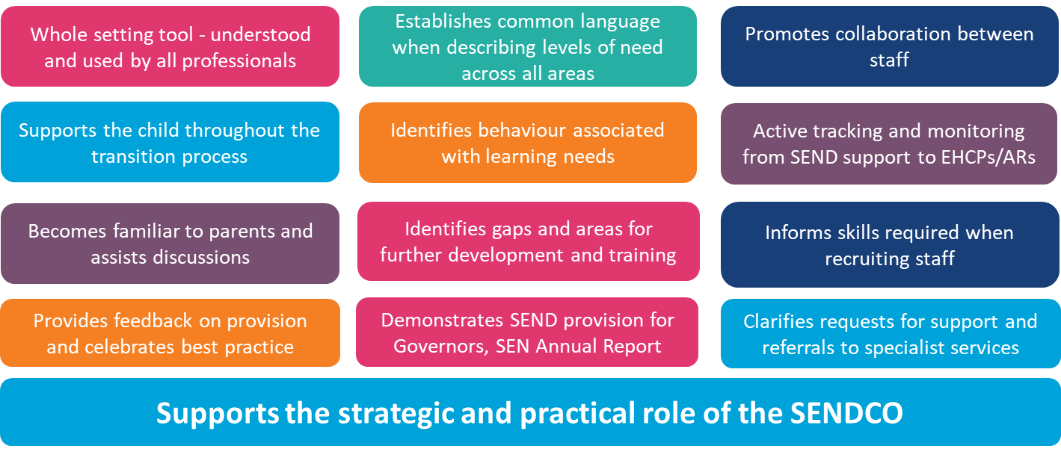
Schools and settings are using Valuing SEND to plan their provision, and both map and meet the needs of all their SEND pupils

Slide 43
Valuing SEND | Tool completion at a glance
Summary
Setting readiness
Needs descriptors
Home confidence
Support planning
Enter the child/ young person’s details.
Evaluate your setting's readiness to meet this child/ young person's level of need using support prompts. This may be done in collaboration with colleagues
Use the needs descriptors to rate the level of the child/ young person's needs across the five domains
Parent/carer or family evaluates their confidence to meet this child/ young person's level of need at home using support prompts in conversation with practitioner
Use support prompts as a starting point to plan support around needs to work towards identified outcomes

Slide 44
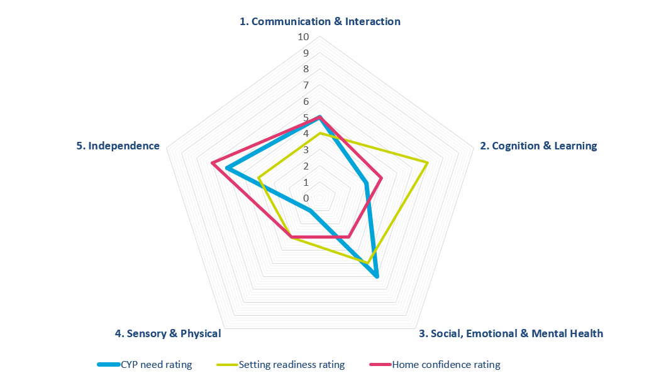
Valuing SEND | Tool completion at a glance
The tool produces an ‘at a glance’ radar chart which maps:
The readiness of the educational setting to meet needs across the 5 domains
A child or young person’s needs across 5 key domains – cognition and learning, communication and interaction, sensory and physical, social emotional and mental health and independence
The confidence of the home environment to meet needs across the 5 domains

Slide 45
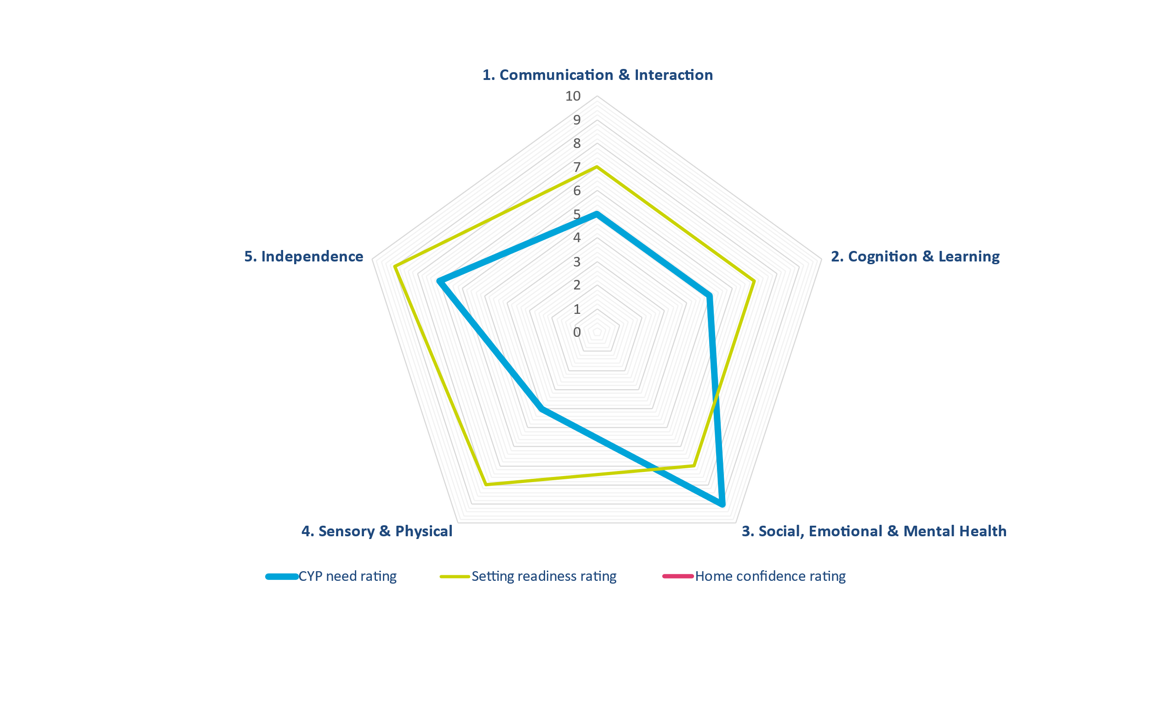

Valuing SEND | Improving outcomes
Tom has a diagnosis of ADHD. He displays highly sexualised language and behaviour. Tom’s outbursts include swearing and inappropriate touching of peers. Mother reports similar behaviour at home.
The SENDCo had significant concerns that Tom is at risk of permanent exclusion.
Changing the conversation: VSEND and the strengths-based approach
• The review demonstrated that the school’s interventions are meeting most of Tom’s needs.
Tom’s behaviour is impacting negatively on his progress
Tom’s behaviour is disrupting the learning of his peers
School has reported to professionals that Tom is at risk of permanent exclusion
Tom’s parent is struggling to support him with diet and behaviour at home
School is providing Art Therapy.
The BOSS team is involved with this case regarding Tom’s behaviour.
VSEND demonstrates clearly that Tom’s needs are being met largely by interventions in his mainstream school.
Actions:
Tom’s sexualised behaviour to be further assessed through re referral to CAMHS
Clarity of roles and responsibilities between services
Parents to be supported re on line safety at home
Review of impact of ADHD medication on his weight and behaviour
Referral to school nursing re weight management
The amended EHCP to focus on Tom’s SEMH needs through a co-ordinated response from specialist services in school and at home
Notes:
Here is a case study of a child who was at risk of exclusion. Before we look at the detail let’s see how much detail we can get just from looking at the radar chart

Slide 46
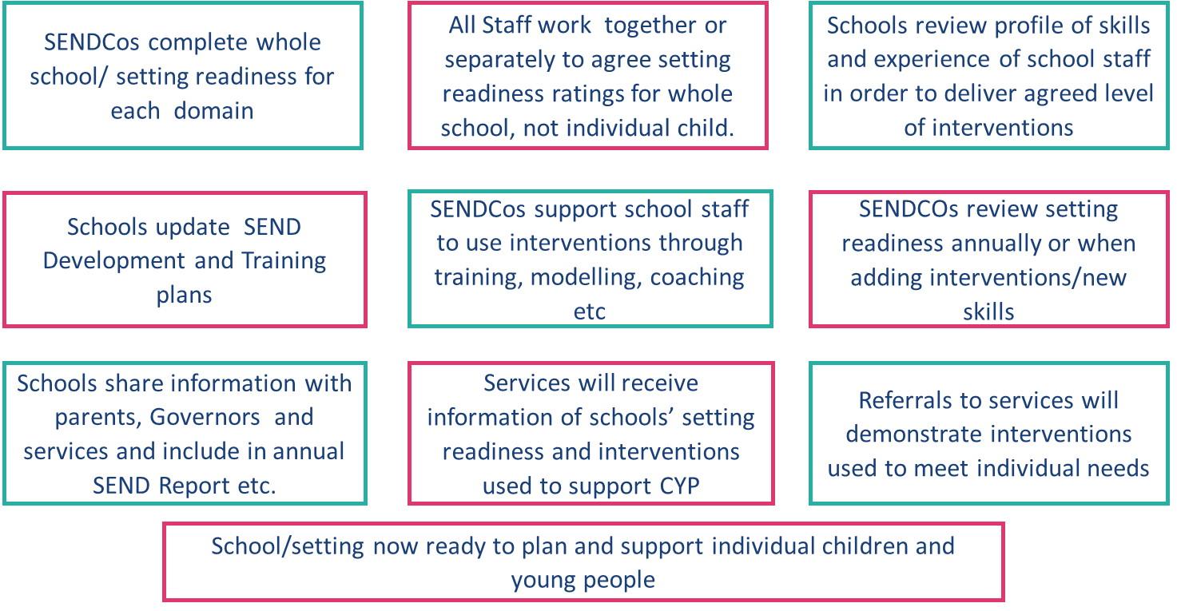
Valuing SEND | The Importance of Setting Readiness

Slide 47
Valuing SEND | Some of the benefits
Promotes collaboration between staff, establishing common language when describing levels of need across all areas
Supports the strategic role of the SENDCO
Active tracking and monitoring of progress during SEN Support and from EHCPs to ARs
Supports the work of the SENCO when carrying out learning walks and observations and training
Supports the child throughout the transition process
Identifies behaviour associated with learning needs
Becomes familiar to parents and assists discussions with professionals
Identifies gaps and areas for further development and training, informing training needs.
Provides active feedback and opportunity to celebrate best practice
Demonstrates SEND provision for Governors, SEN Annual Report, website etc.
Clarifies referrals to specialist services and requests for statutory assessment
Informs skills required when recruiting staff.

Slide 48
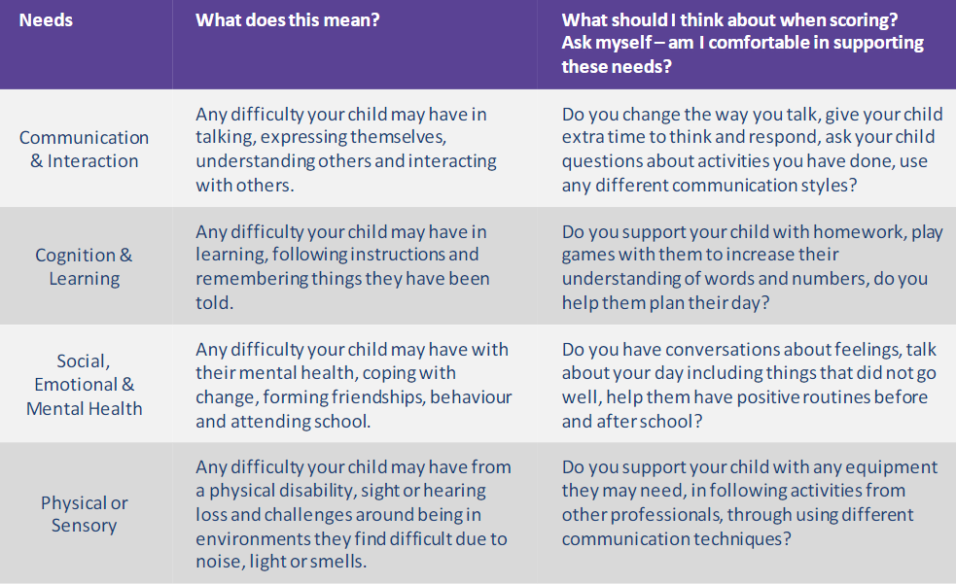
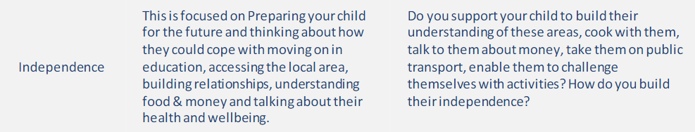
V SEND | The importance of home confidence
The home confidence section is about understanding how confident a family feels in supporting their child in managing and improving their needs outside of school.
The tool asks families to score their confidence between 0 (no confidence at all in supporting their child’s needs) and 10 (they feel confident supporting their child’s needs).
There is no right or wrong answer when it comes to the home confidence rating; it is purely based on how confident the family feel.

Slide 49

Final thoughts
.

Slide 50


Kirklees MST

Slide 51
What is Multisystemic Therapy (MST)?
Community-based and family-driven treatment
Focus is on empowering parents and carers to solve current and future problems
We focus on school attendance and achievement in our outcomes

Slide 52
What is MST?
MST has a strong track record of client engagement, retention and satisfaction
MST therapists work in close partnership with the young person's family, school and community
MST is delivered over a period of 3-6 months
Therapists have low case loads in order to provide families with an intensive programme of intervention
Provide 24/7 on call

Slide 53


MST Kirklees
Existing Kirklees teams:
MST
MST-E (Exploitation)
MST-FIT (Family Integrated Transitions)

Slide 54
MST SEND
Access to reports on Gateway e.g. EHCP, Educational Psychologist assessments
School Functional Analysis
School observations to understand behaviours
MST-FIT confirm with the Virtual School their alliance on all FIT cases
Currently involved in research with Royal Holloway University of London to improve education outcomes in MST

Slide 55
MST SEND
38 current cases
8 x EHCP’s
1 x being assessed for EHCP
14 pending allocation
1 x EHCP
1 x being assessed for EHCP

Slide 56
Kirklees MST Educational Outcomes
MST outcomes:
Ultimate - attending school
Instrumental – sustained success in school
Kirklees MST (January 2019 – February 2022)
85.80% attending 75.93% success

Slide 57

Any questions?

