Slide 1

Welcome to SENCoNet
Autumn 2024

Slide 2
8:45 – 9:00 | Networking
9:00 – 9:10 | Welcome and Introductions | Sarah Grant
9:10 – 9:30 | Designated Social Care Officer Children with a Disability Team | Sarah Schofield
9:30 – 9:50 | Musica Kirklees Inclusion | Jennifer Isaacs
9:50 – 10:10 | Designated Clinical Officer role | Mel Watkin
10:10 – 10:30 | Break
10:30 – 10:50 | SENDACT updates | Jenny Sneideris
10:50 – 11:10 | Adoption and Special Guardianship Support Fund | Debs Goddard
11:10 – 11:30 | Dingley’s Promise | Jill Taylor

Slide 3
New to SENCo/New to Kirklees
Training course Spring 2025:
28.01.25 pm face to face session in Civic Centre 1
11.02.25
27.02.25 Online twilight sessions
10.03.25
Opportunities to find out about the resources and support available
Consideration of key aspects of the SENCo role
Opportunities to network and share good practice

Slide 4

EYFS
The monitoring survey for Reception Transition Funding will be coming out soon. This will only be sent to those schools that are receiving this funding for eligible children. Responses are required to support decision making regarding continuation of funding, so please can you ensure that you complete this.

Slide 5
Our Kirklees Futures Wellbeing Conference –
“Well-being for your school community”
8th November 2024 9:00-15:45
A full day conference with keynote speakers:
Adrian Bethune, Author, Lecturer and founder of Teachappy.co.uk
“Can you Teach Happiness?”
Andy Mellor, Strategic Lead – Carnegie Centre of Excellence for Mental Health in Schools
“A Whole School Approach to Mental Health”
There will be 15 workshops to choose from. These will cover a range of aspects of wellbeing.
The conference is aimed at all Primary and Secondary Schools and Early Years settings.
It is for any Senior Leader/Manager, HT, DHT, SENCO, or anyone with an interest and responsibility in supporting well-being across the school and its community
COST: £75 for the first place, £50 for a second place
To book on go to SLA Online (sla-online.co.uk)
If you are outside of Kirklees LA please contact 01484 414708 or email business.solutions@kirklees.gov.uk
Notes:
Need to book on by end of week

Slide 6

The role of the Designated Clinical Officer
MELISSA WATKIN

Slide 7

Why do we need a DCO?
The Designated Clinical Officer is recognised by the SEND Code of Practise as an expert health practitioner on all matters relating to CYP and SEND. The SEND and Disability Code of Practice 2015 introduces the DCO role under the Section 3.45.

Slide 8

Role of the DCO
The Designated Clinical Officer for SEND will ensure health’s compliance with the legislation and spirit of the SEND Code of Practice leading to improved outcomes for children and young people with special educational needs and disability.

Slide 9

The DCO will ensure that the outcomes for disabled children and young people and those with Special Educational Needs are maximised by working to improve; quality of life, school absences, mental and physical health problems, personal autonomy and involvement in further education and employment, independent living and community inclusion.

Slide 10

I have oversight and create assurance across all health services 0-25 delivering healthcare to children and young people with SEND.
I ensure that health components of SEND policy and procedures are updated and communicated.
I coordination and create assurance of strategic health’s input into the EHC process and reporting of health’s position and audits to quality committees.
I champion co-production as a way of working within and across health.
I provide system leadership across health on all matter relating to CYP, SEND and Health.

Slide 11

I Facilitate timely completion of relevant Health assessment and reports for statutory EHC needs assessment.
I make recommendations for the delivery of health provisions in EHC plans is being made in the most appropriate forum.
I am responsible for creating resolution of disagreement on health issues/provision with parents and young people, and with the Local Authority.

Slide 12

I engage with social, education and health care providers and other stakeholders to promote the needs of SEND children.
I engage with support and facilitate the development of networks for a range of people who are involved in the delivery of the SEND agenda.
I also engage with regulators and commissioners to continue to develop high quality support and services in the ICB place.

Slide 13

I sit on relevant health and interagency committees. We advise Education Services, schools and other relevant agencies, including social care, on health matters relevant to SEND.
I also support schools with their duties under the ‘Supporting pupils with Medical Conditions’ guidance, in conjunction with the multidisciplinary health team.

Slide 14

I advise the Local Authority to support effective strategic commissioning of health services that will meet the education, learning and training need or social care needs of children with SEND. This will include an annual report of activity, demand and service gaps.

Slide 15

I have line management and leadership responsibility of the ICBs children's team with oversight of Continuing Health Care, Transforming Care and Complex Mental and Physical Health.

Slide 16



I work closely with our Designated Medical Officer and our newly appointed Designated Social Care officer to improve outcomes and enhance our joined-up working across the Kirklees Partnership.

Slide 17

About me:
I’ve been in post for 14 months, some of you may have already worked with me.
I came to the West Yorkshire ICB from the South Yorkshire ICB.
I am a qualified nurse and I have a specialist School Nursing qualification.
I have significant experience of supporting CYP and their families particularly across Mental Health, SEND and Public Health.

Slide 18
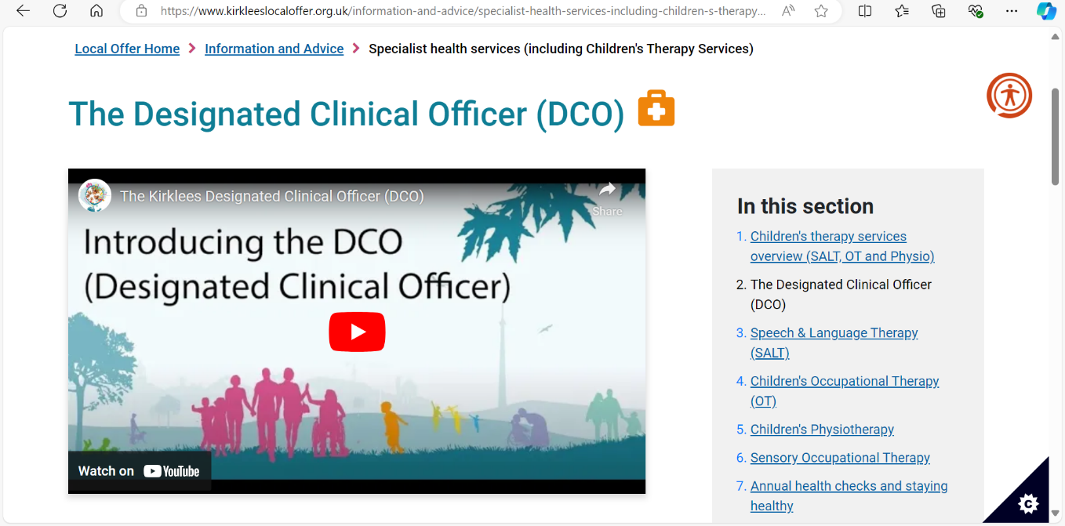
Find me on the Local Offer website https://www.kirkleeslocaloffer.org.uk/information-and-advice/specialist-health-services-including-children-s-therapy-services/the-designated-clinical-officer-dco/

Slide 19


Slide 20
Designated Social Care Officer (DSCO) for SEND
Sarah Schofield, Service Manager.

Slide 21
Why a DSCO?
After a series of regional Action Learning Sets held in 2017/18 the development of the role of the DSCO was identified as one of three themes to be developed in more detail through national Accelerated Working Groups (AWGs).
CDC have been exploring the ways that local areas have been developing their approaches to ensuring high quality social care input and engagement with the Education, Health and Care needs assessment and planning process, and the wider SEND framework.

Slide 22
The DSCO role in Local Authorities
key focus of the Designated Social Care Officer (DSCO) is to support & develop the social care elements of the SEND strategy and ensure they are embedded within our working practice for children and young people aged 0 to 25 across all services.
The post is positioned in Children’s Social Care and sometimes education.
A key aspect to this role is to work collaboratively and strategically across health, education and social care to enable system change.
Available as a point of contact for parents/carers, partner agencies and professionals to support the resolution of SEND queries and concerns related to the quality and interaction of Children’s Social Care and Early help for families of children and young people within special educational needs.

Slide 23
DSCO role in Kirklees
Continue to manage the Children with a Disability Service
Be part of the SEND Transformation within Kirklees
Work closely with education and health and other partners with a focus on SEND
Work closely with parents, carers and young people to understand what is needed

Slide 24
Key focus of the role
• A focus on unblocking barriers for children and families
• Enabling children and families to access the right services at the right time
• Acting as a resource to teams to explore services for children in line with the Local Offer and improving understanding of the Local Offer by professionals and families

Slide 25
Key focus of the role
• Improved professional understanding of the EHC needs assessment and planning process
Embedding a culture of co-production in support of children’s needs assessments and EHCPs
• Improvement in the quality of EHCPs, including Section A in relation to social care
• Improved understanding of Social Care processes by professionals in Education

Slide 26
What Kirklees hope to improve
Better outcomes for children and families
• Improved social care input to Education, Health and Care Plans (EHCP)
• Bringing the Social care and SEND systems together
• Improving knowledge and understanding of SEND across all areas of Social Care
• Improving knowledge and understanding of Social Care across the SEND system

Slide 27
Next Steps
• Building links with Parent Carer Forum.
Working closely with Designated Clinical Officer.
Developing social care process for EHCP assessment and review.
Developing social care templates for EHCP assessment and review.
Linking with regional DSCO- learning from other Local Authorities.
Local Area SEND Inspection - Delivery Plan- ensuring Social Care are around the table!
Review of SEND universal offer of social and leisure activities
Developing working relationships with health, education and other partners

Slide 28

Musica Kirklees
Jennifer Isaacs - Inclusion Officer
Jennifer.Isaacs@musicakirklees.org
Senco network meeting
23rd October 2024

Slide 29
Who are Musica Kirklees?
Five Music Centres across Kirklees
School based lessons
Large musical events
We deliver small group, individual and whole class lessons in most schools across Kirklees.
Paid for by parents, schools, PTAs or the virtual school
Regular Big sings for all schools to get involved with
SEND Music Days
Play Days and get togethers throughout the year
5 music centres; Batley, Mirfield, Shelley, Colne Valley and Holme Valley
Central ensembles to aid progression

Slide 30
Opportunities for SEN Pupils
Creative Nurture Groups
Adapted Instruments
One to one tuition
SEND Network meetings
SEND Music Days
Free tuition for Children who are looked after

Slide 31
Adapted Instruments
Capital Grant from the Department of Education
Adapted instruments can be for student with physical disabilities but also pupils with additional needs that may require help holding an instruments or focusing during a lesson
We hope to purchase several iPads for pupils who want to create music in a different way – and these will be available to use
Subscriptions to inclusive music making apps are also available.

Slide 32
One to one tuition
Pupils with SEN would benefit from having individual music lessons
Pupils can work to achieve exams (ABRSM, Trinity, P-Levels, Sounds of Intent Framework)

Slide 33

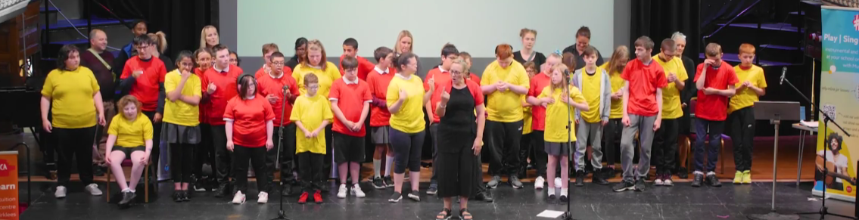
SEND Music Days

Slide 34
Creative Nurture Groups
Aims
To give greater confidence to children who, for a variety of reasons, struggle in the classroom
To give children a sense of agency
To allow children a safe space in which to express themselves and try out new things
Expectations
Strong links between what is happening in WCET classes in school, but not exclusive in content or delivery.
The group will consist of the same children, no new children will be introduced to the group once established.
The group will not change in the year, or term depending on the need of the school
The venue and timing of the group needs to stay the same for the whole year
Content of Sessions
Structured
Nurturing
Playful
Curiosity
PERMA Model Outcomes
Positive
Emotion
Engagement
Relationship
Meaning
Achievement

Slide 35


Connected Persons
Support Team
Adoption & Special Guardianship Support Fund
Supporting Family & Friend Foster Carers,
Special Guardianship Orders
and Child Arrangement Orders

Slide 36

What is the Adoption & Special Guardianship Support Fund?
The Adoption & Special Guardianship Support Fund (ASGSF) was established to help pay for essential therapy services for adoptive families as and when they need it.
It was set up because many families need some kind of support during and following adoption and too many have struggled to get the help they need in the past.
From 1st April 2016, the Fund became available to families who have children placed on Special Guardianship or Child Arrangement Orders, who were looked after immediately prior to the order being granted.

Slide 37

Who is eligible for support from the ASGSF?
The ASGSF is available for children and young people up to and including the age of 21, (or 25 with an EHC plan) who:
Are adopted
Were Looked After immediately prior to the Special Guardianship Order (SGO) or adoption order being granted.
Are under a Residency Order (RO) or Child Arrangement Order (CAO) and were previously looked after
Were previously looked after but where the adoption, SGO, RO or CAO placement has broken down, irrespective of any reunification plans

Slide 38
What is the Adoption & Special Guardianship Support Fund?
The adoption and special guardian support fund (ASGSF) provides funds to local authorities and regional adoption agencies (RAAs) to pay for essential therapeutic services for eligible adoptive, special guardianship order (SGO) and child arrangement order (CAO) families.
The ASGSF model is based on the existing statutory framework for the assessment of adoption support, SGO or CAO support needs and the provision of support services.

Slide 39
How can I access funding from the ASGSF?
The local authority that places a child with a family is responsible for assessing that family's support needs for 3 years after the order is made. After 3 years, the responsibility lies with the local authority where the family lives.
Carers have the right to request an assessment, and the Local Authority is required by law to conduct one.
In Kirklees, the Connected Persons Support Team completes these assessments and submits applications to the fund.
Families will be placed on a waiting list to be allocated a worker to progress the application.

Slide 40
How can I access funding from the ASGSF?
The Connected Persons Support Team will:
Check the child is eligible to access the fund.
Complete the assessment with the family, with input from other professionals to consider if therapeutic support is needed.
Together we decide what support is needed.
Support the family to select the right provider to meet the child and carers needs, from an approved provider list verified by ASGSF.
Apply to the ASGSF to secure the funding
Attend reviews with the provider and family, and make further applications to ASGSF if required.

Slide 41
Maximum funding allocations for each child
Until the end of March 2025, the ASGSF will have fund limits per financial year:
£2,500 per child per year for specialist assessment
£5,000 per child per year for therapy
This is currently under Government review for April 2026.

Slide 42

How to access advice and guidance for ASGSF
If schools have a child or children who they feel may be eligible for ASGSF and who would benefit from therapeutic intervention, please contact:
CPST.Support@kirklees.gov.uk and a member of the team will call you to discuss, and if appropriate agree next steps.

Slide 43


https://dingley.org.uk
Notes:
Ann Van Dyke – Summer term input – technology issues. Could not be here today so EYSEND here to give update on the current training offer from DP

Slide 44



Supporting children in the early years with special educational needs and disabilities to achieve their full potential.
A charity delivering specialist nursery provision for children with SEND
  Working with children, families and mainstream providers
  Thousands of children and families supported over 40 years
  Supporting transition into mainstream settings
A will to drive an inclusion movement
  Training for 30,000 practitioners with 96% who complete saying they can take more children with SEND
  Working across the UK with LAs, providers, partners & parents
  Building SEND inclusion in the Early Years.
  Lobbying for change nationally
https://dingley.org.uk
Notes:
Who are Dingley’s Promise – overview of the Charity - leading on developing inclusion within Early Years settings

Slide 45
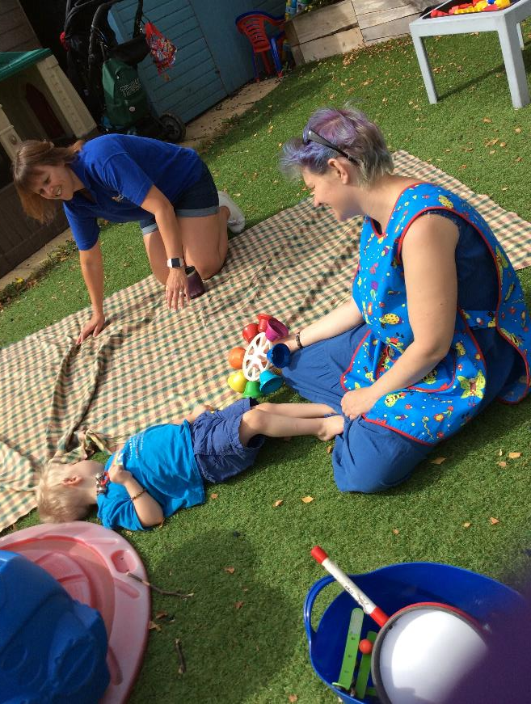
Early Years Inclusion Programme – Comic Relief
Children with SEND are not taking up early years and childcare entitlements to the same extent as their peers
There is a shortage of inclusive places
Research shows training and confidence are critical barriers
Dingley’s Promise want to make a difference – Building SEND inclusion in the Early Years
Notes:
Why the comic relief bid – children with SEND and families facing barriers

Slide 46

The aim of the project is…
…to increase the number of young children with SEND accessing early years and childcare places through...
Partnership with Local Authorities
Meaningful Parental Engagement
A National Steering Group
A Comprehensive and extensive training offer we know makes a difference
Notes:
-

Slide 47
Kirklees: The Training Offer
Early Years Inclusion Programme
Free for participating local authorities.
5 year project aimed at increasing practitioner and parent confidence in providing quality mainstream education for Early Years children with SEND
Online training for the whole early year's workforce (aiming to reach 30,000 practitioners)
10 courses in total which are:
- online
- accessible when and where you like
- flexible
- support individuals and can be completed as a team
- aimed at supporting confidence, skills and
practical ideas
Notes:
2 years left of the project – keen to ensure Schools can access this FREE, high quality training offer whilst the opportunity exists

Slide 48

Online training for the whole early year's workforce
10 courses in total with 5 courses out now:
  Introduction To Early Years Inclusive Practice
  Early Years SEND Transitions
  Managing Behaviours that Challenge
  Having Difficult Conversations with Families
  Voice of the child
  A mixture of work book, training videos and practical activities to support learning.
Notes:
Example of workbook to share if people wish to come and access
High quality videos and resources which staff can return too as needed

Slide 49
What you can expect from the training:
You will gain knowledge of:
Best practice for inclusion in Early Years settings.
How to create an environment that enables learning for all children including an awareness of sensory and communication differences.
Teaching strategies that support learning for children with Special Educational Needs and Disabilities.
Teamwork within the setting, and how partnerships with parents and professionals can support and enhance inclusion.
Consider the importance of preparing for and teaching resilience of transitions in children with SEND.
How to support and grow self-esteem, independence, and resilience in children with SEND.
How to support families and the part that they play in supporting successful transitions.
An awareness of your own confidence and the readiness of your settings in supporting and delivering good transitions

Slide 50


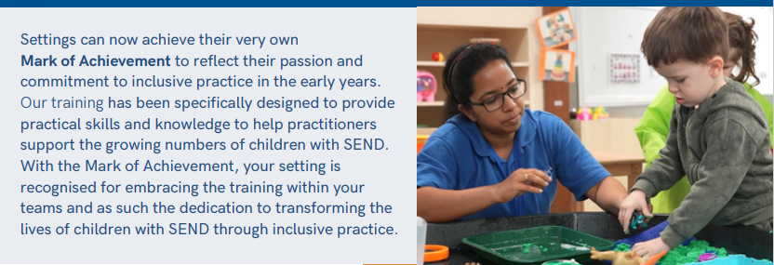

Slide 51
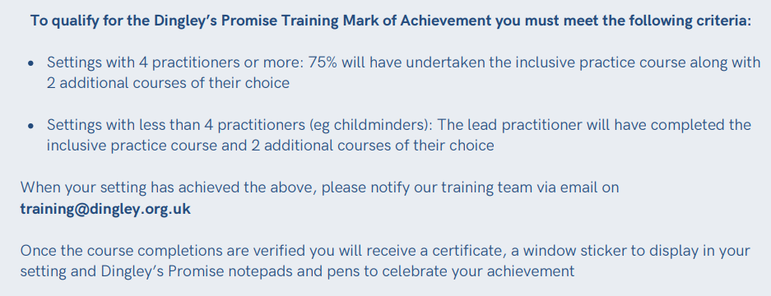

Slide 52

Celebration !
Mark of Achievements
12 PVI settings
4 Schools
Flatts Nursery
Spring Grove JIN School
Meltham Moor Primary School
Crow Lane
Notes:
Success to date.

Slide 53
Feedback from Kirklees staff:
“It has helped me to have conversations with and support parents who are struggling with their children’s behaviour give them ideas to keep the child safe and engaged at home.
“I liked that the training went in depth about how children’s brains develop and function and how they understand the concept of life. It helped me as a practitioner to support their development on a daily basis using variety of knowledge.”

Slide 54

Overall Learner Satisfaction
– All LA’s
Of thousands who have completed the training so far…
99% Feel more confident as a result of the training
96% Believe they can support more children
99% Would recommend this course
99% are committed to making a change in their setting as a result of the training.
NB – data calculated using learner responses collected from our post course surveys.

Slide 55
How?
Assembly times
INSET days
Staff meeting protected time
When children are absent – Cover
Enrichment time – weekly time led by LTS, children have an opportunity to develop a range of skills and interests. Protected time for teachers and support staff.
CPD time prioritised

Slide 56
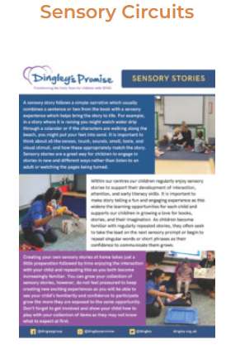
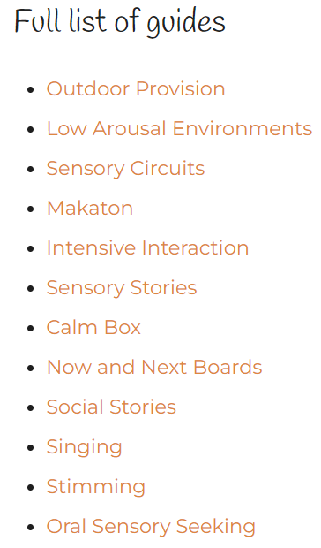
RESOURCES FOR PRACTITIONERS: Guides

Slide 57
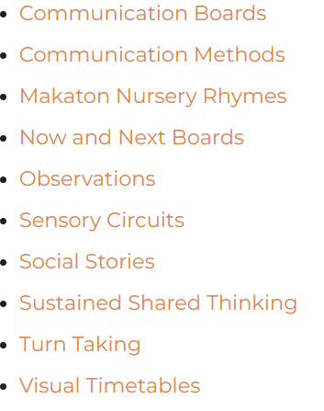
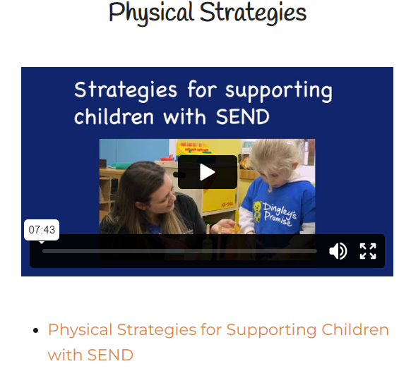
RESOURCES FOR PRACTITIONERS: STRATEGIES

Slide 58

https://dingley.org.uk/dingleys-promise-training/comic-relief/
After signing up Dingley’s Promise will email you directly with next steps

Slide 59

Next steps – get involved!
Sign up and be part of an inclusion movement
Can you be a setting who get our Mark of Achievement?
Sign up to hear our news and know first about webinars, events & opportunities
Lunch breaks and other events too!
Contact EYSEND Outreach Teacher for further info if needed

Slide 60

Thank you for your hard work
and commitment to inclusion!
info@dingley.org.uk

