Slide 1
SEND systems in education settings What teachers should be doing to support Children & Young People with SEND | Getting support in educational settings | Kirklees SEND Local Offer (kirkleeslocaloffer.org.uk) "Educational settings must use their best endeavours to make sure that a child with SEND gets the support they need – this means doing everything they can to meet Children and Young People’s SEND“ (SEND Code of Practice).
Notes:
Laura
Introduce the topic – SEND systems in education settings from 0-25. The workshop is based around the page on the Local Offer, called ‘what teachers should be doing to support children and young people with SEND’.
The SEND Code of Practice gives statutory guidance for Local Authorities, educational settings and anyone else involved in providing services to children or young people with special educational needs or disabilities when working with children and young people (up to age 25). The code clearly states that… (read the quote)
Introduce the team – Sarah (KLP), Anna (SENDCO – Newsome), Laura (ISO) & Holly (ISO)

Slide 2
Child/parental voice Why is it important? Our vision for children with special educational needs and disabilities is the same as for all children and young people that they achieve well in their early years, at school and in college, and lead happy and fulfilled lives. …….the aspirations for children and young people will be raised through an increased focus on life outcomes, including employment and greater independence’.
Notes:
Holly
Why is the child voice important? And pivotal in plans, so they are successful?

Slide 3
What Children & Young People would like…
Ask me what my access needs are, before you do anything else
Tell me a bit about yourself before I meet you ( a photo profile or similar) Are you the right person for me?
Ask me how best to communicate with me
Adjust your communication to ‘meet me halfway’.
Offer me choices of ways to communicate e.g. email, text , face to face, images, drawing, letters, through an advocate
Think universal design and accessibility; things like captions on video calls should be business as usual
If you can’t answer my question straight away, let me know you’re working on it and will get back to me
Communicate directly with me, not just through my parents/carers
Support me to advocate for myself and help me to develop the skills to do this effectively ( ‘let me have a say and give me some help to have a say’)
Be prepared to develop your own skills in listening and communicating with me
Make an effort to understand, and don’t judge
Respect me, my experiences, and my perspective
‘How people talk to you and how they explain things is important; explain things clearly’
Notes:
Holly

Slide 4
How we capture child voice.
· Creating a Lego model of your ideal school to enable a child to show what they like and don’t like at school · Drawing or sculpting from playdough someone who is important them such as a teacher , family member or pet. · Creating a ‘worry monster’ from art materials that represents their worries about transition. · Using a tablet to create an online book about themselves · Free phone apps available from app stores such as C board ( picture based) and Speech Assistant (text and emoji based) · Drawing ( you don’t have to be an artist!) · Note pad and pen ( sometimes it is easier to write down difficult things than find the words verbally) · Talking mats – https://www.communicationmatters.org.uk/what-is-aac/types-of-aac/talking-mats/
Notes:
Holly

Slide 5
Quality First Teaching Quality First Teaching is a whole-class teaching concept that focuses on inclusive and high-quality teaching for every child in a classroom, regardless of their background. QFT uses a variety of different learning methods, such as differentiated learning and the use of SEND resources, to meet the diverse needs of learners. This includes children who may have a SEND need. Be inclusive by design, not as an afterthought
Notes:
Sarah
A child is not considered to have a SEND need just because they are falling behind/finding things difficult. Small interventions through Quality First Teaching may be enough for the child to catch up and thrive in education. It is only when Quality First Teaching is not having an impact that a child may be considered to have SEND, and needs are further assessed.

Slide 6
Quality First Teaching How do Kirklees support this? Kirklees have produced audits and toolkits for schools and settings to use, to support them in ensuring that their practise is as strong as it can be, meeting the needs of a range of different needs within their setting.
Notes:
Laura

Slide 7
Inclusion Counts – Section A – Early Years settings
Available here - Inclusion Counts | Early Years | Kirklees SEND Local Offer (kirkleeslocaloffer.org.uk)
Notes:
Laura
This guidance is a practical resource that aims to help all practitioners to be confident supporting children with Special Educational Needs and or Disabilities (SEND). It has been produced in line with the principle that every Early Years practitioner is a practitioner of children with SEND. This guidance has been developed primarily to support mainstream settings but will also be useful to other professionals across education, health and social care who work with settings in supporting children with SEND. This guidance promotes the importance of early identification of need and early intervention using the graduated approach. It is important to acknowledge that good universal inclusive high-quality practice teaching for children with SEND is good practice for all. It can be used as a valuable tool for individual practitioners as well as for whole settings. This will ensure consistent standards of good practice for all staff across all settings.

Slide 8
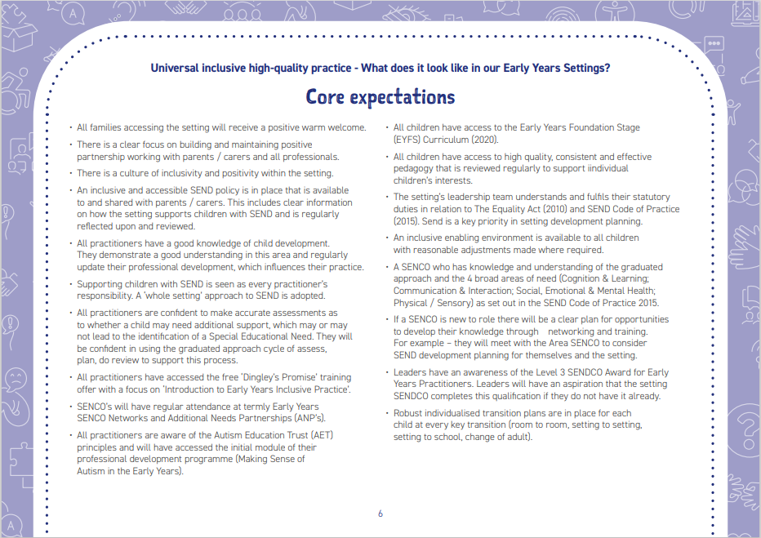
Inclusion Counts – Section A – Early Years settings
Notes:
Laura

Slide 9
Inclusive High Quality Teaching Audit Tool – School settings
Available here - Inclusive High Quality Teaching toolkit | Kirklees SEND Local Offer
Support is available to all education settings in Kirklees around Quality First Teaching & SEND Support through the Inclusion Support Offer, more information is available here - Help for SENCO's and education professionals - The Inclusion Support Offer
Notes:
Holly
This document provides a comprehensive range of strategies to help teachers remove barriers to learning. It has been created as an Audit Tool because schools told us they wanted it to be a practical, user-friendly working document that teachers can revisit time after time
Explain how the ISO role works for schools

Slide 10
Inclusive High Quality Teaching Audit Tool – School settings
Early assessment and intervention
Parent Communication and Input
Information Gathering and observations
Adaptive Teaching
Pastoral Care
Social Time offer
Support in lessons
Staff Communication and briefing
Learning Guide / MSP
SEMH / Wellbeing
Springboard / catch up
Case Study: Female, year 9, ASD Diagnosis in year 7
Arrived in school with no SEN paperwork
Initial obs and transition support identified need
Struggled in year 7 to settle
IEP in place
Wellbeing support and intervention took place (nurture, therapeutic stories, SULP)
Key worker assigned
Sensory needs met
MSP creation to offer further learning and holistic support
Social time safe space
Friendship group support
Cognition support- dyslexia and dyscalculia screener
Needs are met – succeeding with minimal support
Notes:
Anna

Slide 11
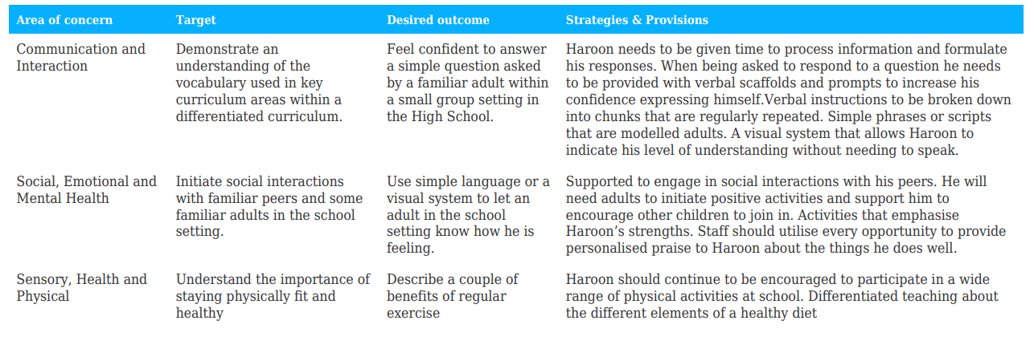
Support Plans There are a huge variety of plans that schools can use to support children to make progress through Quality First Teaching. More common plans are Individual Educational Plans (IEP’s), Individual Learning Plans (ILP’s), Pupil passports etc. None of these plans are legal documents. A child can be placed on a support plan whilst still being supported through Quality First Teaching.
Notes:
Anna

Slide 12
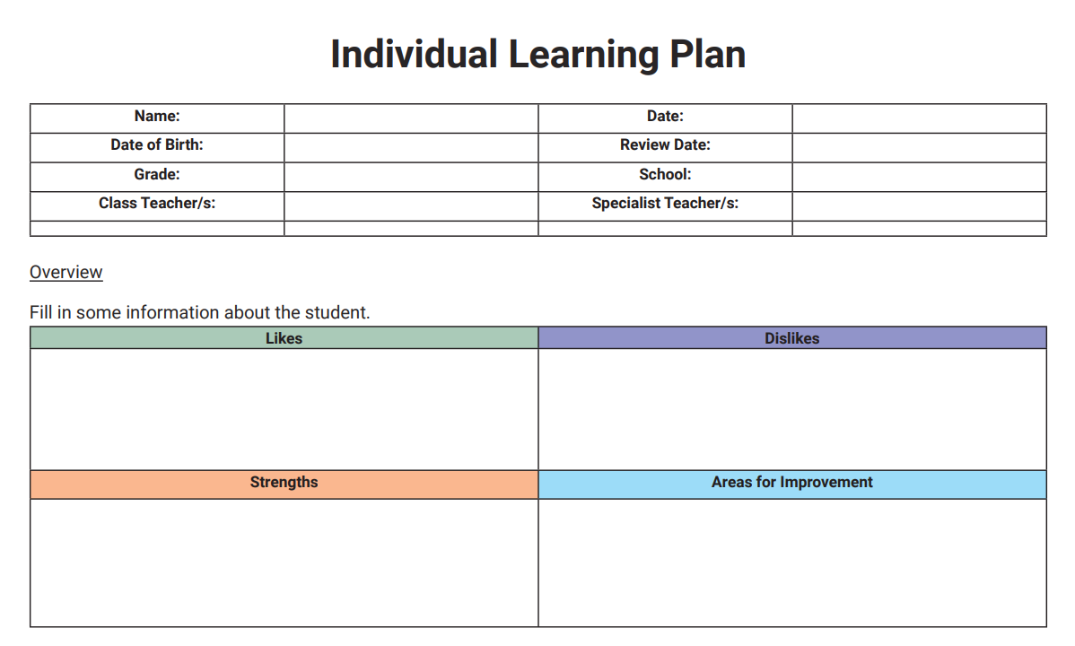
Support Plans - QFT .
Notes:
Laura– talk through some examples

Slide 13
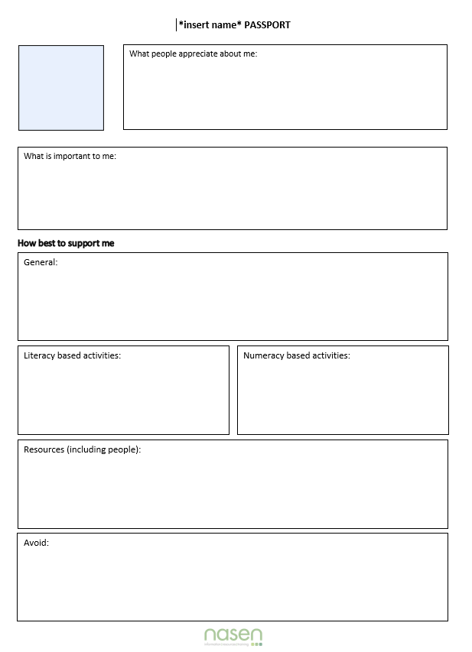
Support Plans
Notes:
Laura– talk about different support plans

Slide 14
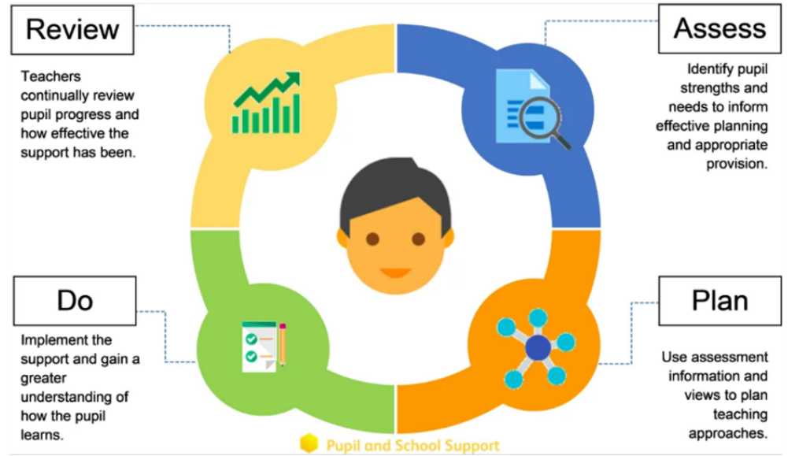
The Graduated Approach The Graduated Approach is a four-step cycle of Assess, Plan, Do, Review that aims to understand and meet the SEND needs of a child or young person to ensure progress. The cycle encourages earlier decisions to be made and actions to be taken for a child to make progress. It is a holistic approach and should not be a single process, but a continuous review and there may be more than one cycle in progress at the same time. Through the cycles, a growing understanding of the child or young people’s needs are identified which allows educational settings to support the child or young person to secure good outcomes.
Notes:
Sarah

Slide 15
The Graduated Approach
What do Kirklees do to support education settings with the Graduated Approach?
Kirklees have produced a range of documents to support education settings for children with more complex needs, whose needs cannot be met with Quality First Teaching alone.
All the strategies from QFT should still also be implemented consistently, whilst identifying further strategies through the review cycle and supporting documents.
There are 7 documents available to education settings to support them:
Notes:
Sarah

Slide 16
School Graduated Approach Documents
Inclusion Counts | Early Years
Notes:
Sarah

Slide 17
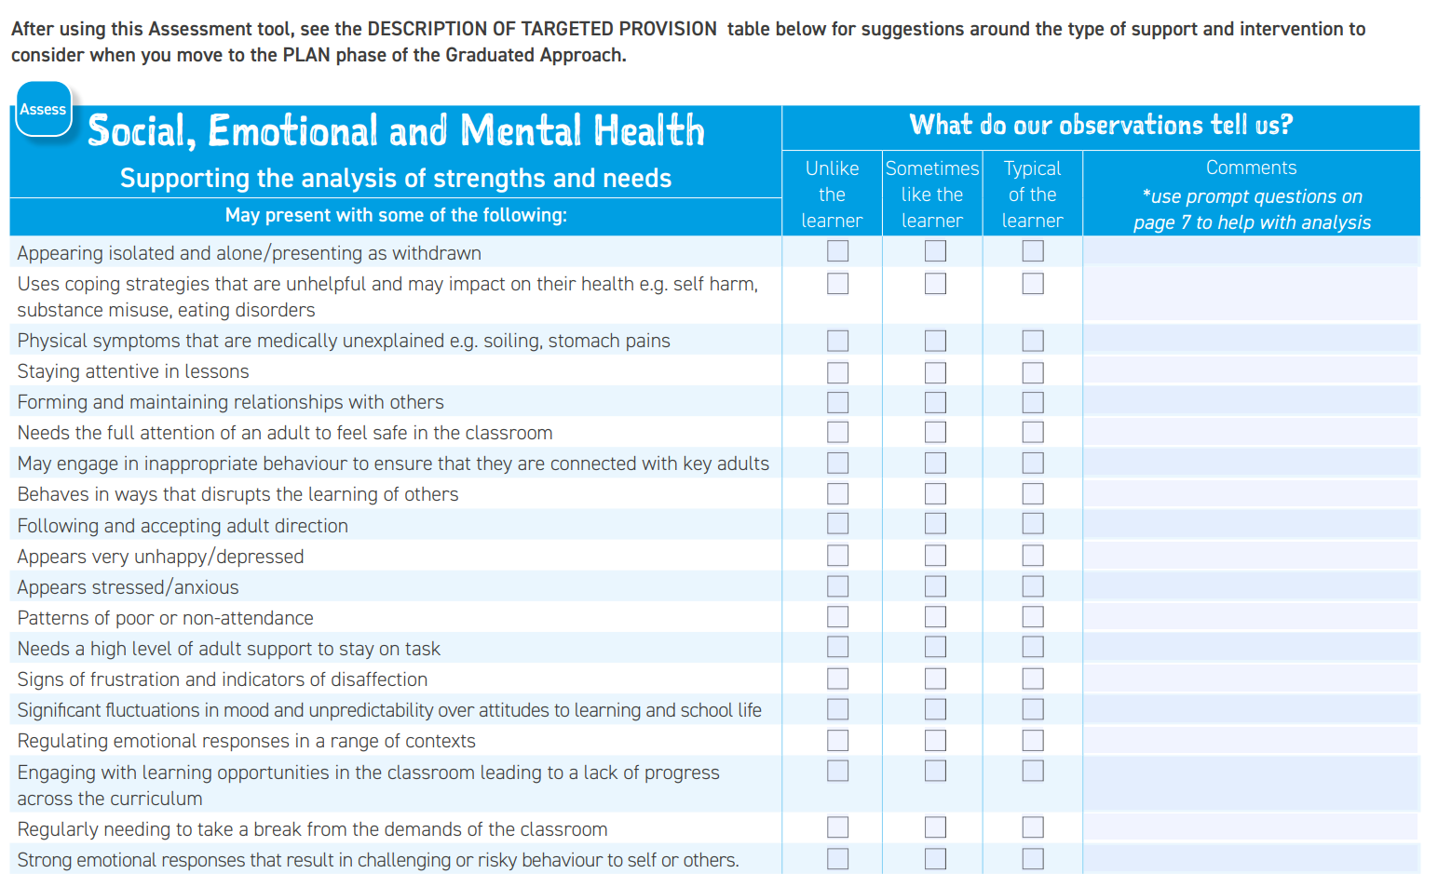
Notes:
Sarah

Slide 18
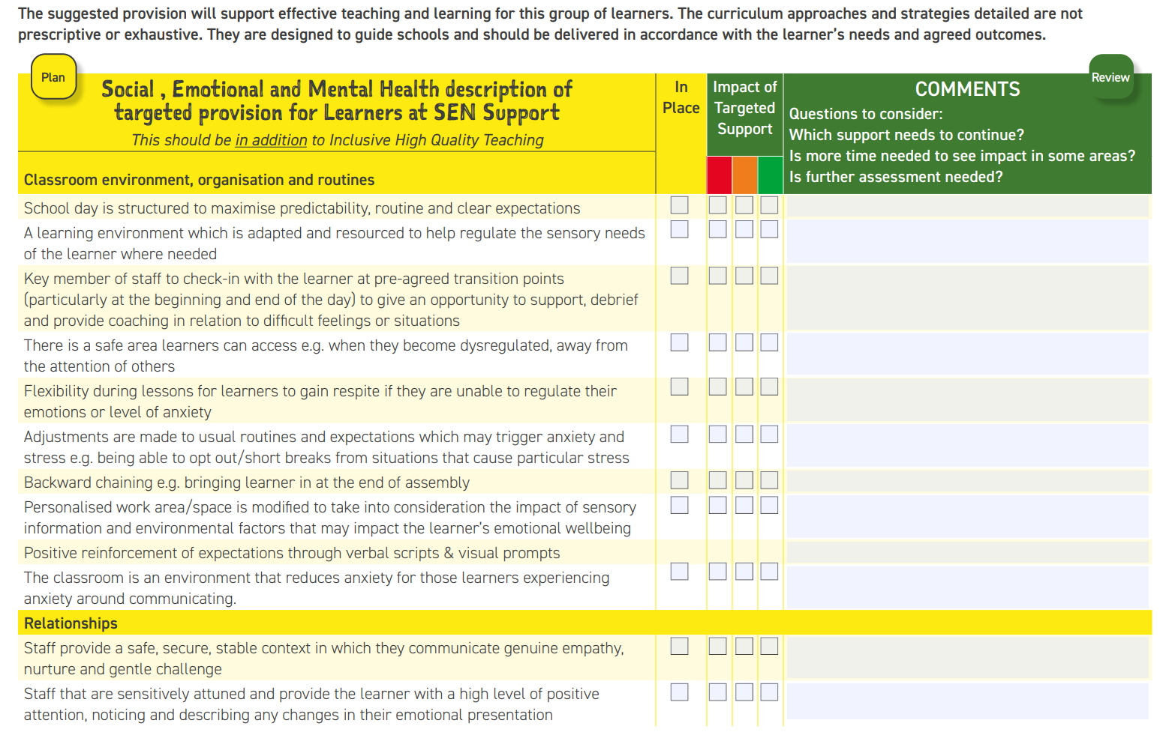
Notes:
Sarah

Slide 19
Support Plans – The Graduated Approach Education settings can use the Graduated Approach documents to support them in evidencing the support they are providing for children and young people. There are also a range of different plans that can also be used, such as a My Support Plan (MSP) or an Individual Assess, Plan, Do, Review plan (I-APDR). Schools can also create their own plans. It is good practise to review these plans at least 3 times a year (termly) with parents/carers of the child or young person as well as any relevant professionals. The child’s voice should also be reflected within these plans & they should have a say on the plan, where appropriate. None of these plans are legal documents. These plans are usually put into place when a plan under Quality First Teaching is not having the desired impact and a child is not making progress. More information is available here - IEP's ANPs, provision maps and I-APDR's and MSPs | Getting support in educational settings | Kirklees SEND Local Offer (kirkleeslocaloffer.org.uk)
Notes:
Holly

Slide 20
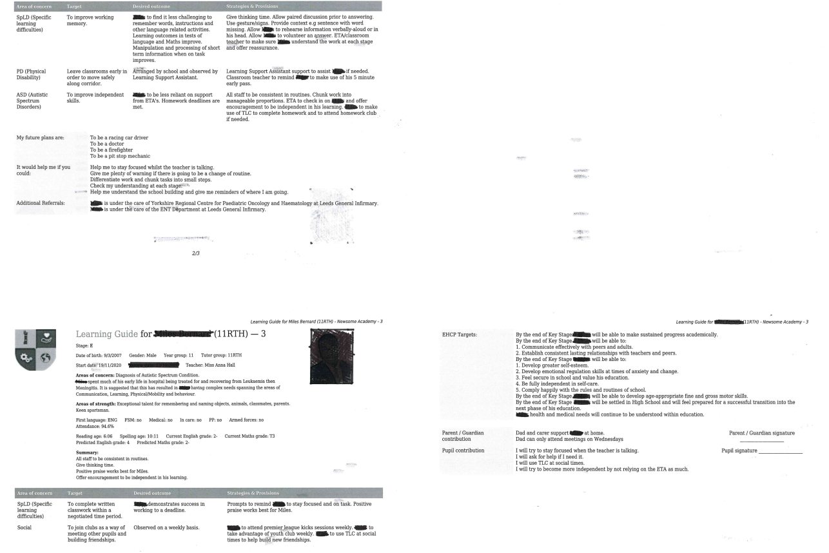
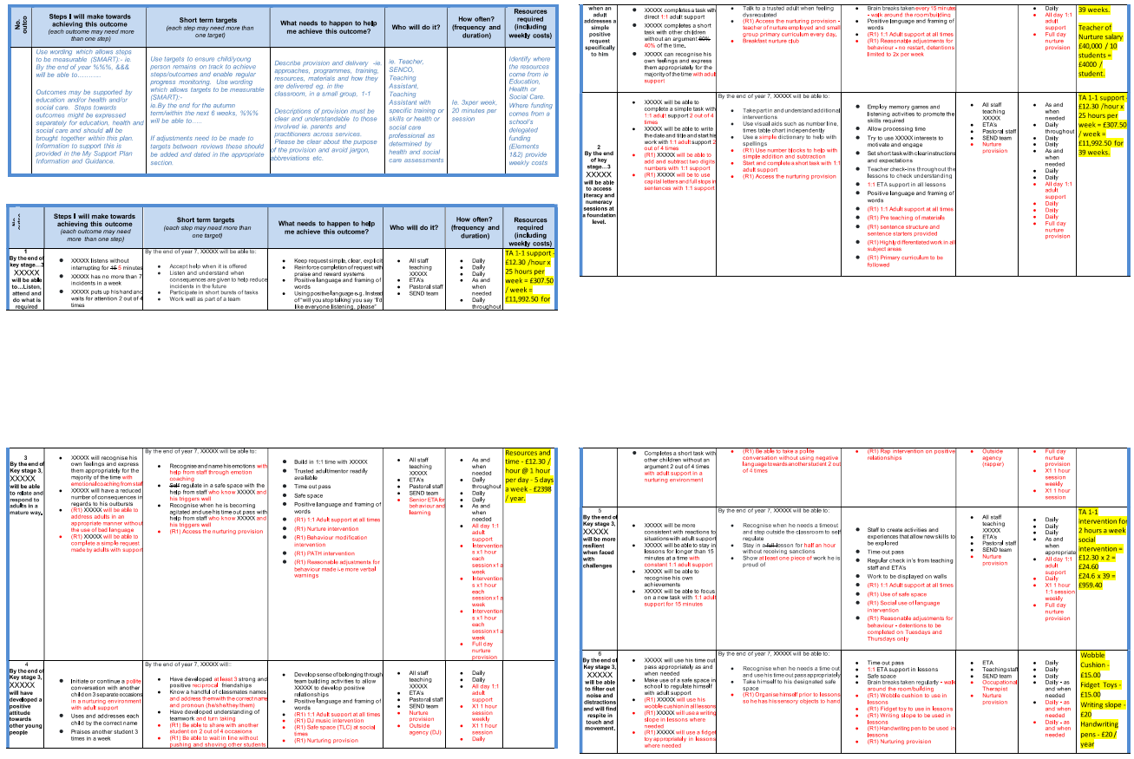
Notes:
Anna

Slide 21
Case Study: Year 9 Male KH
No paperwork at point of transition or external agency involvement
Learning Guide on entry after a robust transition plan and relationships developed
Extreme High level of need in all areas and not succeeding in school (on verge of PX, high number of suspensions, risk to himself and others…)
Referral for ADHD
MSP in place and reviewed every 6 weeks
CPD for all staff delivered
Bespoke mentoring and intervention programme
1-1 support and bespoke TT including social time 1-1
OT assessment took place
At risk in the community
EHCP referral made
ADHD and ASD diagnosis given (including medication)
RISE alternative provision established in school offering bespoke and alternative curriculum
Notes:
Anna

Slide 22
Further support available for schools Kirklees have a range of different services available to educational settings, which support schools to provide the most inclusive school experience for children and young people with complex needs, whose needs cannot be met by Quality First Teaching and the Graduated Approach. Different teams have different referral criteria, but the general consensus is that schools must have evidence meaningful action and support through an effective support plan.
Notes:
Laura

Slide 23
Educational Health &Care Plan’s (EHCP) An EHCP is a legal document which describes the special needs and disabilities (SEND) of a young person (from 0 – 25) as well as what help they need in an educational setting to help them make progress and learn. They are for young people who have complex additional or special needs (SEND)and need more help in an educational setting than most children or young people. If a school feels that the child is not making the desired progress through Quality First Teaching and the Graduated Approach, they may consider applying for an EHCP to support the young person. Parents must consent to an EHCP request. Parents can also make the request themselves. More information is available here - Education, Health and Care Plans (EHCP's) - The Local Offer
Notes:
Sarah

Slide 24
One size DOESN’T fit all.
Notes:
Laura
Children don’t fit in boxes. There are exceptions to the rule & we have to ensure that with every decision we make, the child is at the centre of that. There may be times where the SEND journey cannot be followed, it’s about good quality conversations with professionals and everybody working together with the same shared outcomes – for children to succeed and thrive in whatever journey they’re on.

